Slide 1
BTEC Sport - Revision
Component 3

Slide 2
Learning Aim A -
EXPLORE THE IMPORTANCE OF FITNESS FOR SPORTS PERFORMANCE

Slide 3
Skill related
- Agility
- Balance
- Coordination
- Power
- Reaction time
Components of Fitness
Physical
Aerobic endurance
Muscular endurance
Flexibility
Speed
Muscular strength
Body composition

Slide 4
WOW WORD
Components of fitness quiz
Literacy outcome: Use the key words correctly.
Challenge: Can you identify a fitness test for each component?
Key Words:
Task:
1 – What are the Skill related components of fitness
2 – What is speed x strength
3 – What is the range of movement possible at a joint
4 – What are the components of physical fitness
5 – What training method has a series of different stations
6 – What is your maximum heart rate
7 – What is the ability to change direction at speed
8 – What does the sit and reach test measure
9 – What does the multi stage fitness test measure
10 – What training method has a period of work followed by a period of rest

Slide 5
WOW WORD
Semiotic
Components of fitness
ANSWERS
Literacy outcome: Use the key words correctly.
Challenge: Can you identify a fitness test for each component?
Key Words:
Task:
1 – Power, Coordination, Reaction Time, Agility, Balance,
2 – Power,
3 – Flexibility,
4 – Muscular Endurance, Muscular Strength, Aerobic Endurance, Body Composition, Flexibility, Speed,
5 – Circuit Training
6 – 220 - age
7 – Agility
8 – Flexibility
9 –Aerobic Endurance
10 – Interval Training

Slide 6
Principles of training
Basic Principles of Training
FITT
F - Frequency (how often to train per week)
I - Intensity (how hard to train)
T - Time (how long to train, for each session)
T - Type (which training method to use to target the components of fitness that needs improving)
Additional Principles of Training
RIPS + VAR
R - Rest and recovery (sports performers need rest to allow body to adapt)
I - Individual differences (meet individual needs of participant)
P - Progressive Overload (gradually increase intensity)
S - Specificity (specific to individuals activity or sport or training goals)
V - Variation (different activities to avoid getting bored)
A - Adaptation (how body reacts to training loads by increasing its ability to cope with those loads)
R - Reversibility (if training stops or intensity is too low, training effects are reversed)

Slide 7
WOW WORD
Principles of training quiz
Literacy outcome: Use the key words correctly.
Challenge: Can you identify a fitness test for each component?
Key Words:
Task:
1 – Which principle of training does this statement refer to 'how often the exercise is performed. (e.g. 3x a week)
2 – What does the 'S' mean in RIPS
3 – Name the principle which avoids getting bored?
4 – Which principle of training refers to the 'period of time set aside for your body to recover'
5 – Which principle of training does this phrase 'if you don't use it, you lose it' refer to?
6 – Which principle of training requires consideration for differing personal needs that each athlete may have?
7 – Which principle of training refers to the difficulty of the exercise?
8 – Which principle of training requires a gradual increase upon the exercise demands on the athlete's body?
9 – Name what the Ts Stand for in F.I.T.T
10 – If an athlete damages muscle or tissue during competition, which principle of training must their coach consider?

Slide 8
WOW WORD
Semiotic
Principles of training
ANSWERS
Literacy outcome: Use the key words correctly.
Challenge: Can you identify a fitness test for each component?
Key Words:
Task:
1 – Frequency
2 – Specificity
3 – Variation
4 – Rest
5 – Reversibility
6 – Individuals needs
7 – Intensity
8 – Progressive Overload
9 – Time and Type
10 – Rest + Recovery

Slide 9

Target zones
An estimate of maximum heart rate is calculated as:
Maximum Heart Rate (MHR) = 220 – age
Aerobic training zone 50%-80% (with oxygen)
Anaerobic training zone 80%-90% (without oxygen)
Worked example:
A 25 year-old would have a maximum heart rate of:
220 – 25 = 195bpm
Notes:
Photo (Heart): © istock Photo

Slide 10
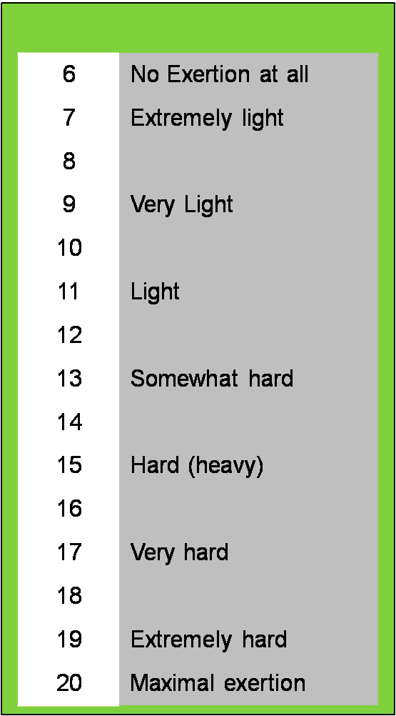

Rate of Perceived Exertion
Borg scale
The Borg scale is a simple method of rating perceived
exertion (RPE) and is used to measure a performer's level of intensity during exercise.
During exercise, the Borg scale is used to assign numbers to how you feel about the exercise undertaken.
Notes:
Photo: © PE Resources Bank

Slide 11

Rate of Perceived Exertion
Rating of perceived exertion (RPE) can also be used to predict heart rate. The following equation is used:
RPE x 10 = Heart Rate (BPM)
PAUSE:
TRY THIS
Perform 10 star jumps on the spot. What is your RPE and estimated heart rate?
Perform 35 star jumps and repeat the process of RPE and heart rate calculation.

Slide 12
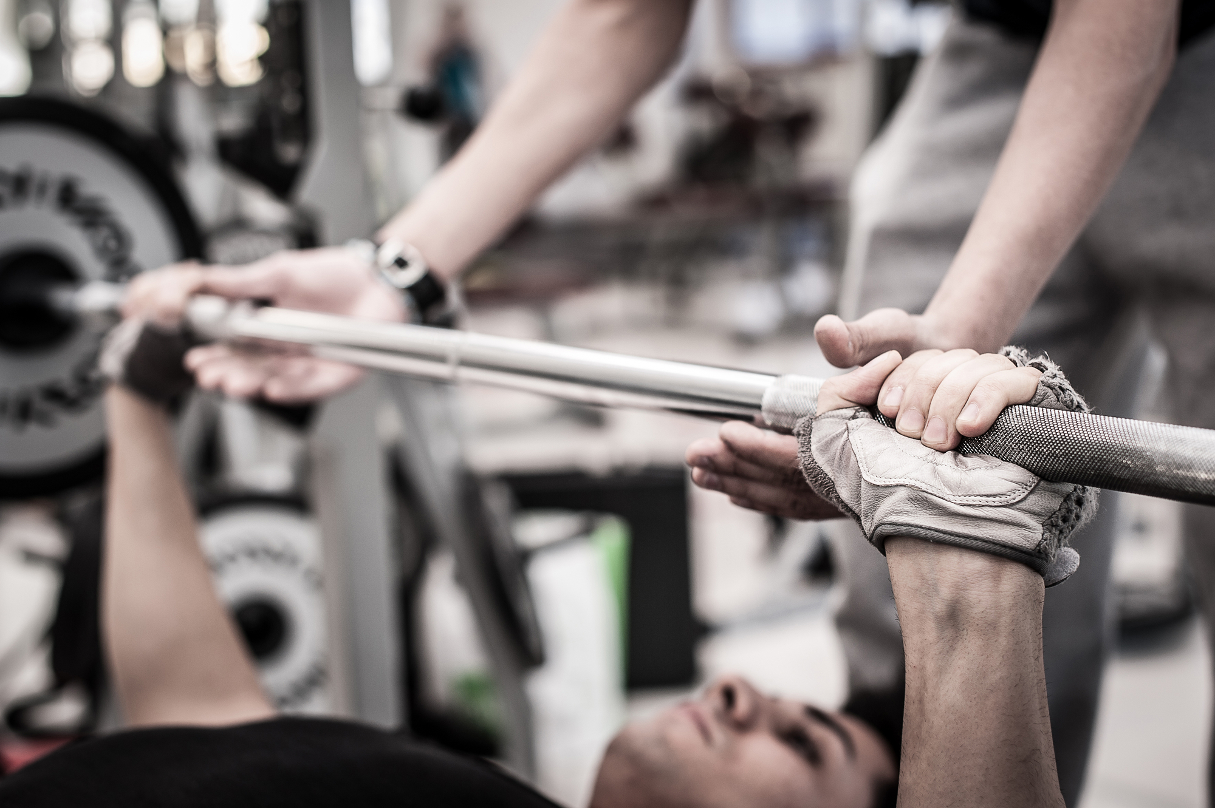
1 Rep MAX and 15 Rep Max
1 Repetition Maximum (1RM) – This is the maximum weight an individual can lift in a given exercise.
15 Repetition Maximum (15 RM) – This is the optimum weight that an individual can lift 15 times in a given exercise. This will improve muscular endurance.
The 1RM test is most commonly used by strength and conditioning coaches to assess strength capacities, strength imbalances and to evaluate the effectiveness of a training programme.

Slide 13
Learning Aim B -
INVESTIGATE FITNESS TESTING TO DETERMINE FITNESS LEVELS

Slide 14

PRE-TEST PROCEDURES
A coach should consider the following points when setting up and carrying out fitness tests on a athlete:
Completed informed consent
Calibration of equipment
A completed Physical Activity Readiness Questionnaire (PAR-Q)
Participant pre fitness test check

Slide 15
Validity, Reliability, Practicality of Fitness tests
Validity is whether the test measures what it's supposed to measure. E.g. 30m Sprint test DOES test speed for a sprinter
Practicality is the quality of being effective or suitable. E.g. Cost, Time taken, How many people can participate at once.
Reliability is a question of whether the test is accurate. It is important to ensure that the procedure is correctly maintained for all to obtain consistency.

Slide 16
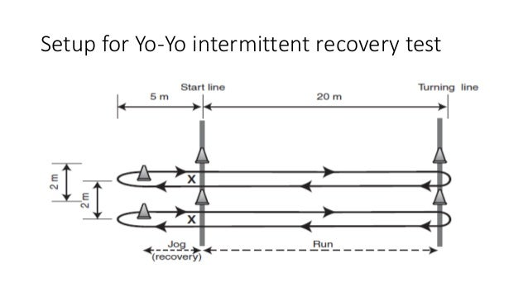
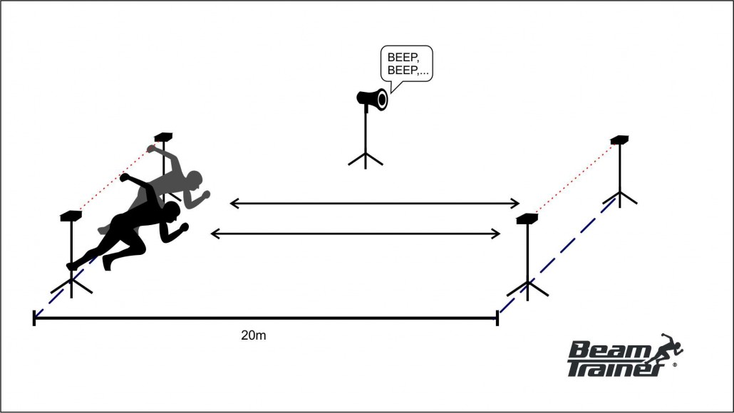
Fitness Tests: Aerobic Endurance- VO2 Max
MULTI STAGE FITNESS TEST YO YO TEST
Wayfair UK | GYOW 4.0 | Category Living Room | 15" | 16x9
HONDA ODD SHAPED BALL

Slide 17
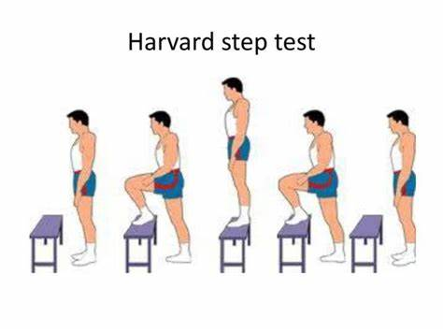
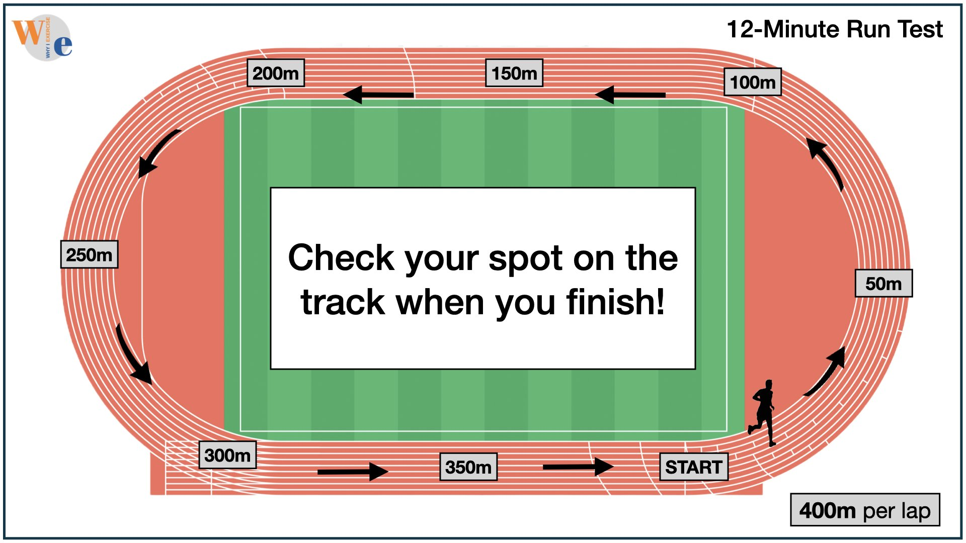
Fitness Tests: Aerobic Endurance- VO2 Max
HARVARD STEP TEST 12 MINUTE COOPER (RUN OR SWIM)

Slide 18
Fitness tests: Muscular Endurance
One Minute Press Up Test (upper body)
One Minute Sit Up Test (abdominals)
Timed Plank Test (core endurance)

Slide 19
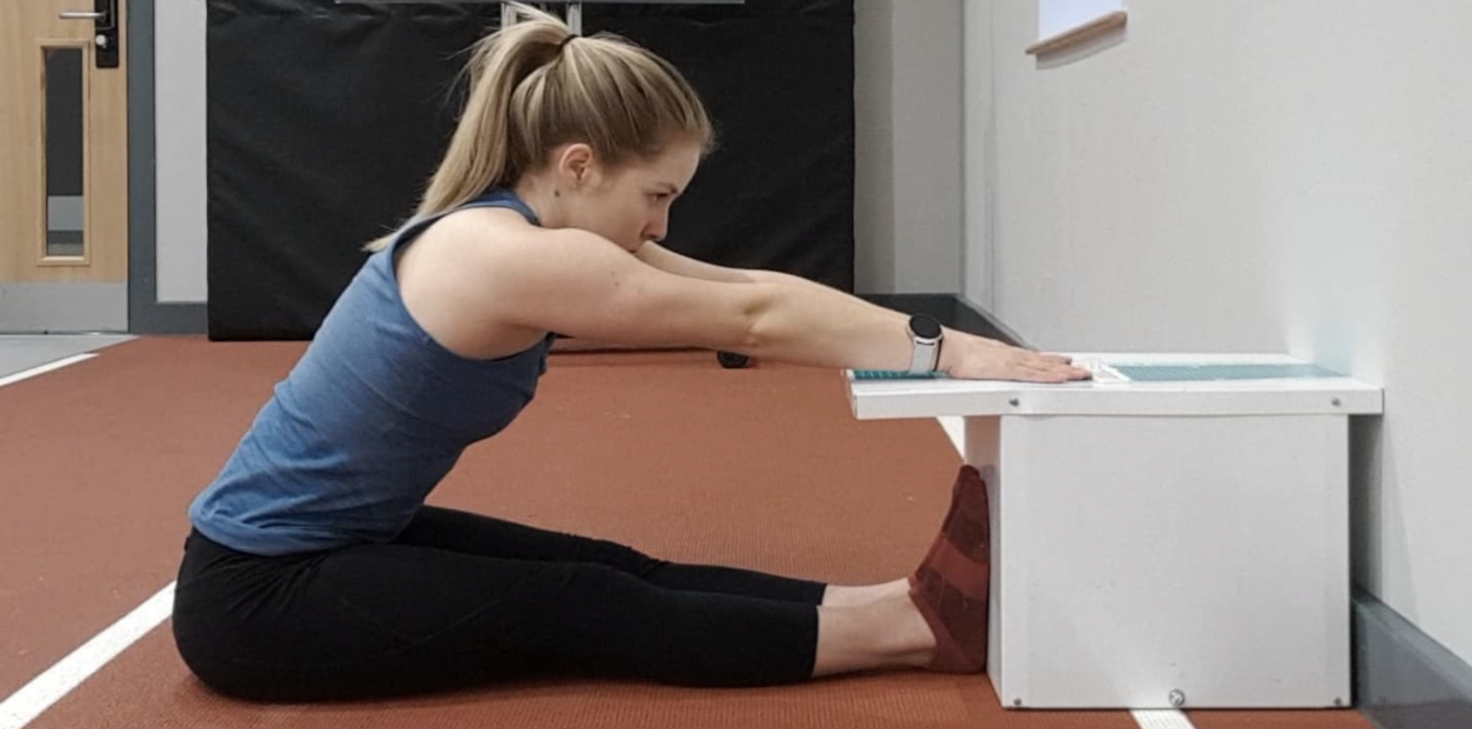
Fitness tests: Flexibility
Sit & Reach Test
Also:
Calf Flexibility Test
Shoulder Flexibility Test

Slide 20
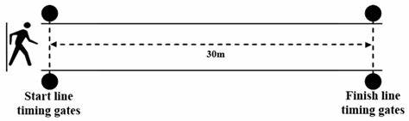
Fitness tests: Speed
30m Sprint Test- Standard
30m FLYING Sprint Test- Running Start (performers run 30m before the timer starts)

Slide 21
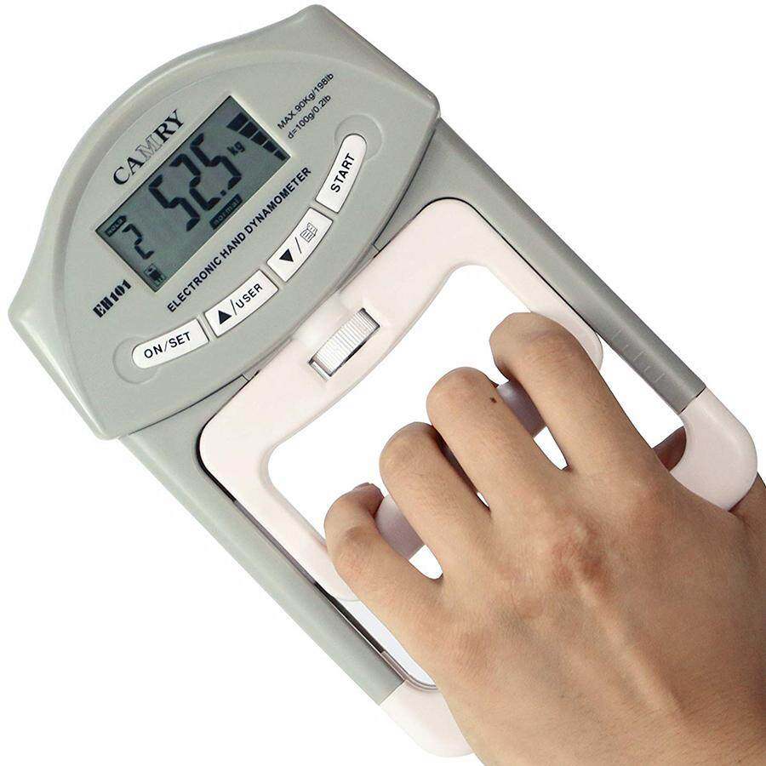
Fitness tests: Muscular Strength
Grip Dynamometer (grip strength)
One rep max test (maximum muscle strength)

Slide 22
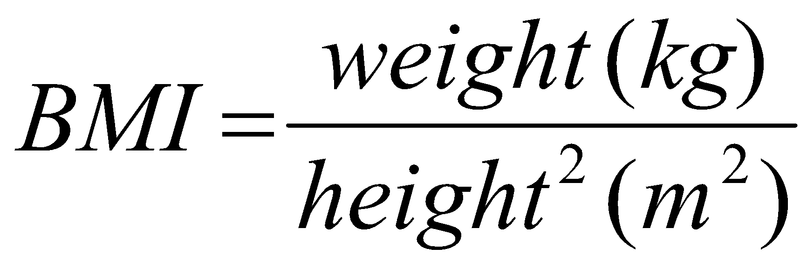
Fitness tests: Body composition
BMI-
BIA- electrodes attached to right ankle and wrist
Waist to hip ratio- divide waist measurement by hip measurement

Slide 23
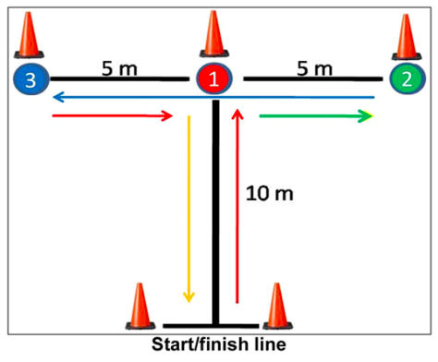
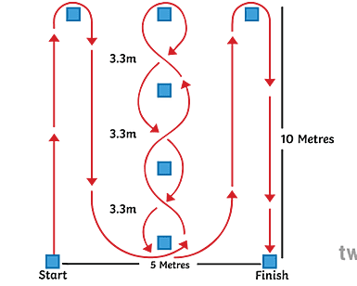
Fitness tests: Agility
Illinois run test T Test

Slide 24
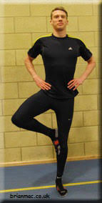
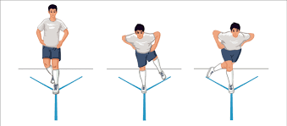
Fitness tests: Balance
Stork Stand Test Y Balance Test

Slide 25
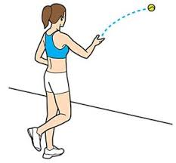
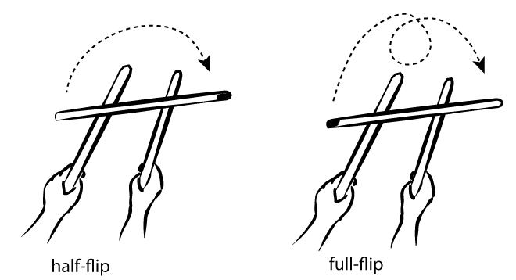
Fitness tests: Coordination
Wall Toss Test
Stick Flip Test

Slide 26
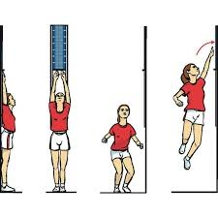
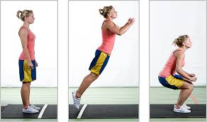
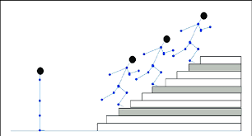
Fitness tests: Power
Vertical Jump Standing long jump Margaria- Kalamen

Slide 27
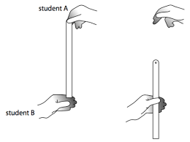
Fitness tests: Reaction Time
Ruler Drop Test
Online reaction time tests

Slide 28
Learning Aim C
Requirements for Fitness Training Methods

Slide 29
Aerobic Endurance Training
Continuous training- non-stop for 30 minutes or more
Fartlek training- Changing the intensity (by using equipment, speed or terrain)
Interval training- work period followed by rest period.

Slide 30
Flexibility training
Static stretching (active- you do the stretch yourself, passive- someone else or an external object helps with the stretch.
Proprioceptive Neuromuscular Facilitation (PNF)- using a partner. 1. Performer stretches the muscle, 2. Partner holds the stretch and performer pushes against them, 3. Performer relaxes, and the partner stretches the muscle again.

Slide 31
Muscular Endurance/Strength Training
Weight training: Strength- High weight, Low reps
Endurance- Low weight, high reps
Weight training can be completed via free weights or resistance machines.
Circuit training can be set out to improve muscular endurance using a range of stations (e.g. lunges, press ups, squats etc.)

Slide 32
Speed training
Acceleration sprints- increasing the pace over a short distance
Interval training- adapt the work period to be of a high intensity

Slide 33
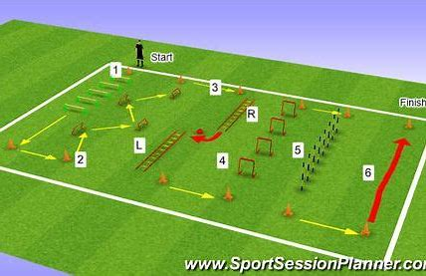
Agility training
SAQ (Speed, Agility & Quickness) training can help performers to move quickly and change direction using ladders, hurdles, cones etc.

Slide 34
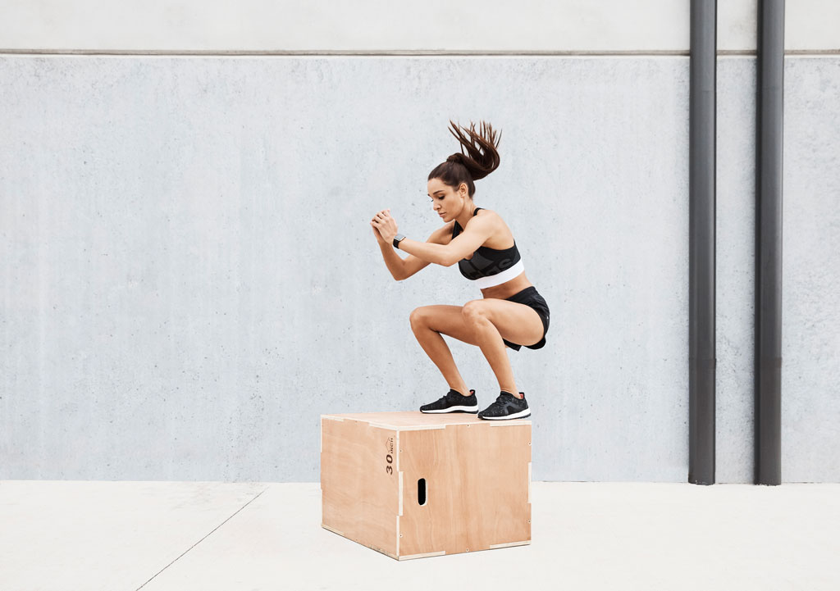
Power training
Plyometric training- this is to help with explosive power for example box jumps.

Slide 35
Choosing training methods
You must consider:
What component of fitness needs improving
Which sport does it most relate to
Cost of equipment
Location available
Set up
Number of participants
Age
Fitness levels

Slide 36

Cardiorespiratory effects of training (Long term)
Aerobic endurance training
Cardia Hypertrophy- when you exercise your heart adapts to the demands and gets bigger and stronger.
A stronger heart will result in an increase in stroke volume ( more blood can be pumped in 1 beat).
Decreased resting heart rate- As stroke volume increases, the heart had to beat less often to pump the same amount of blood around the body, which results in a decrease in resting heart rate.
Faster recovery rates- the body will respond better to the demands of the exercise and so will recover quicker
Increased strength of respiratory muscles (diaphragm, intercostal muscles get stronger)
Increased strength of these muscles improved efficiency of breathing (greater inhalation of oxygen in one breath)
Increased capillarisation around the alveoli's, which increases the rate of gaseous exchange- more oxygen can get into your blood stream and more CO2 can be removed.
Increased lung capacity- how much air your lungs can hold.

Slide 37
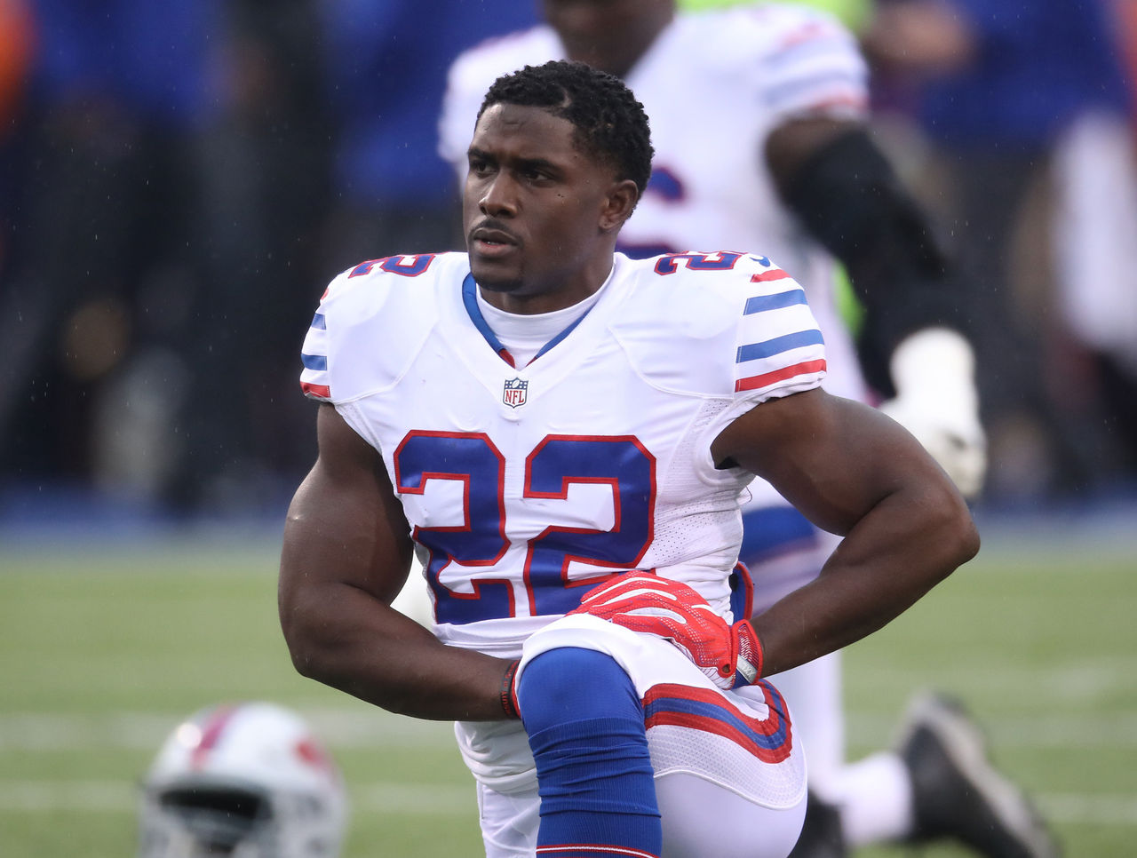

Musculoskeletal effects of training (long term)
Flexibility, Muscular endurance and muscular strength training
Muscle hypertrophy- bigger and strong muscle size
Stronger ligaments and tendons- reduce risks of sprains/injury
Greater bone density- stronger bones
Greater production of synovial fluids at joints- keeps movement smooth
Increase in the length of muscle fibres- allows muscles to produce more force
Increased muscle pliability- smoothness and elasticity of muscles, ligaments and tendons,
Increased muscle tone- degree of tension between muscles

Slide 38
Learning Aim D
Fitness programme personal information

Slide 39
Fitness Programmes
Need to look at what they want to achieve in their sport:
Have a main aim Have smaller objectives
Personal Information needs to be collected so the training is suitable for their needs- PARQ
Then fitness tests need to be completed to identify the component/s of fitness that need to be improved
Then training methods can be selected and principles of training applied

Slide 40
Motivation
Intrinsic: internal factors e.g. feel good factor & enjoyment
Extrinisic: external factors e.g. rewards, money & trophies
Motivation can benefit performers by increased participation, maintaining training, improved performance & increased fitness

Slide 41
Goal Setting- SMARTER
Specific
Measurable
Achievable
Realistic
Time-related
Exciting
Recorded
A training programme will not be effective unless SMARTER goals are set.

Slide 42
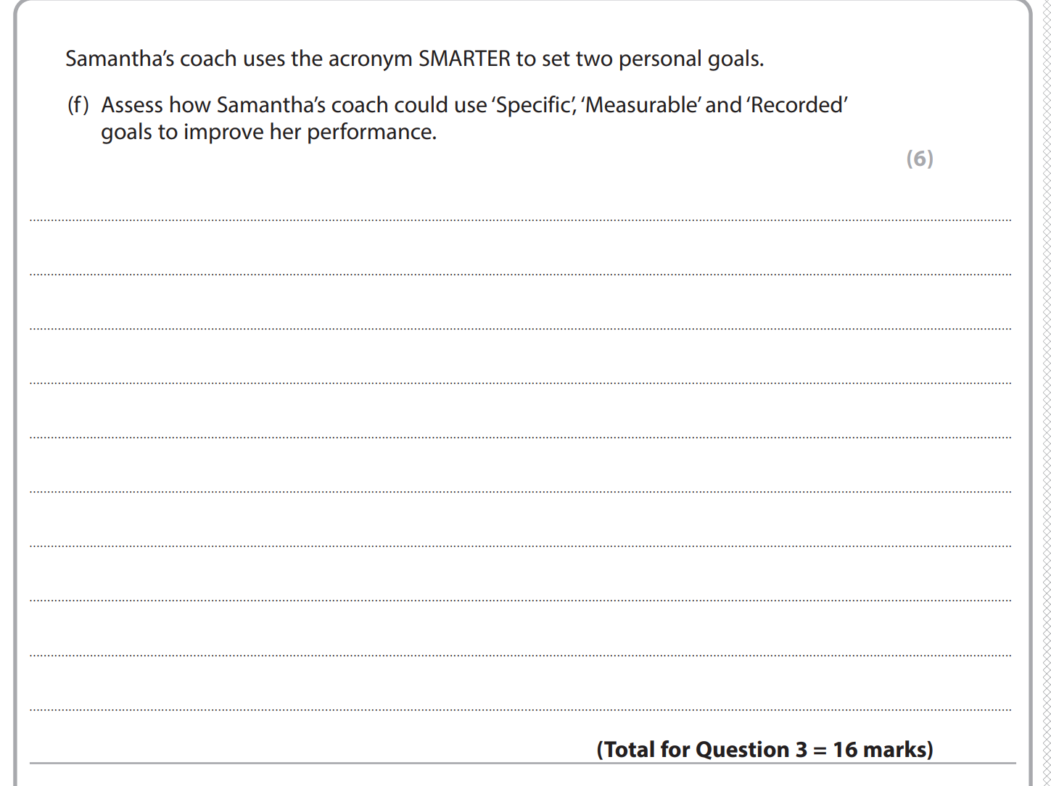
Example question

Slide 43
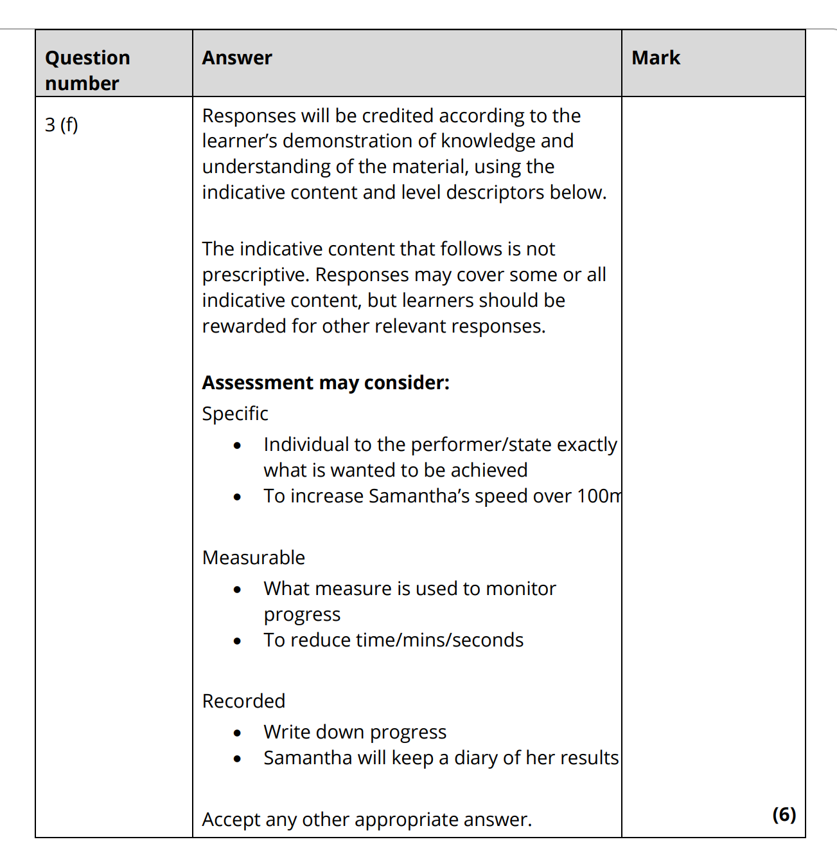
Mark scheme

Slide 44
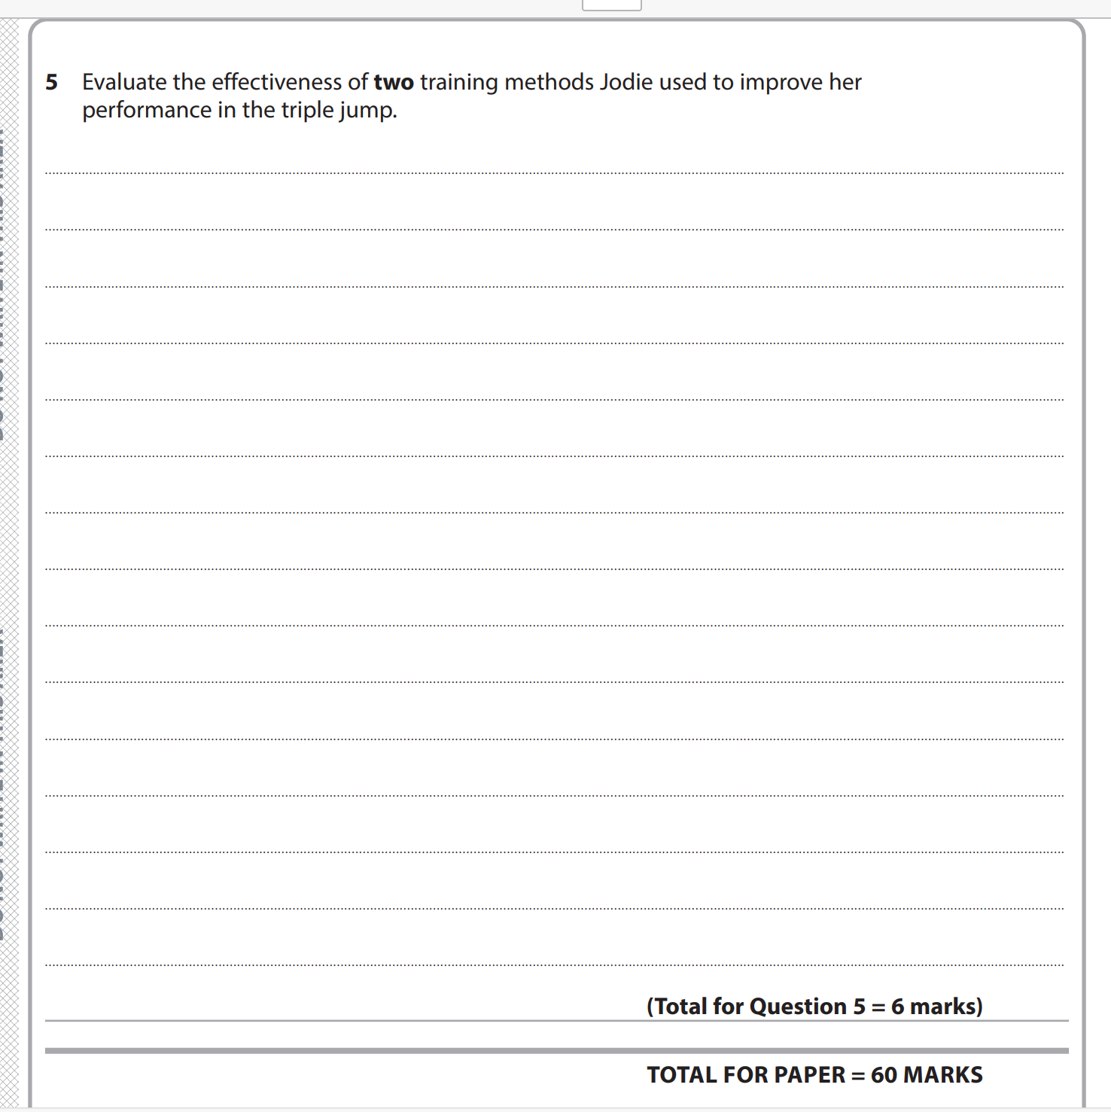
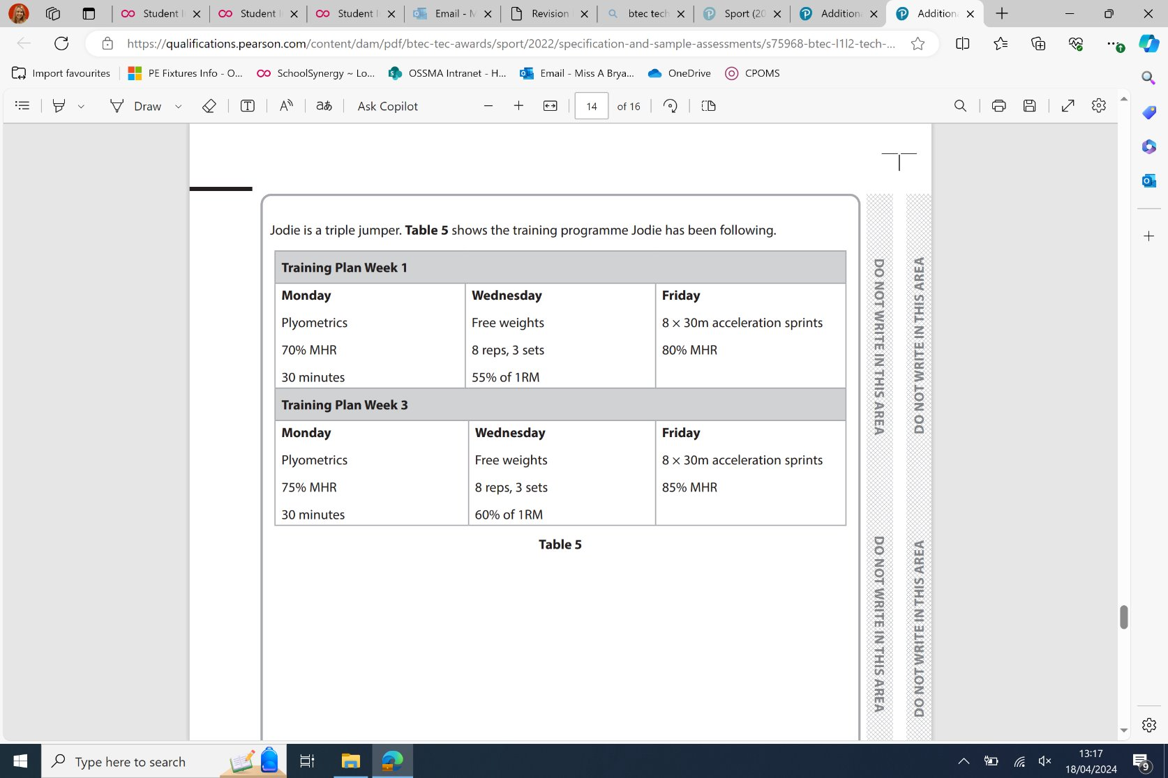
Example question

Slide 45
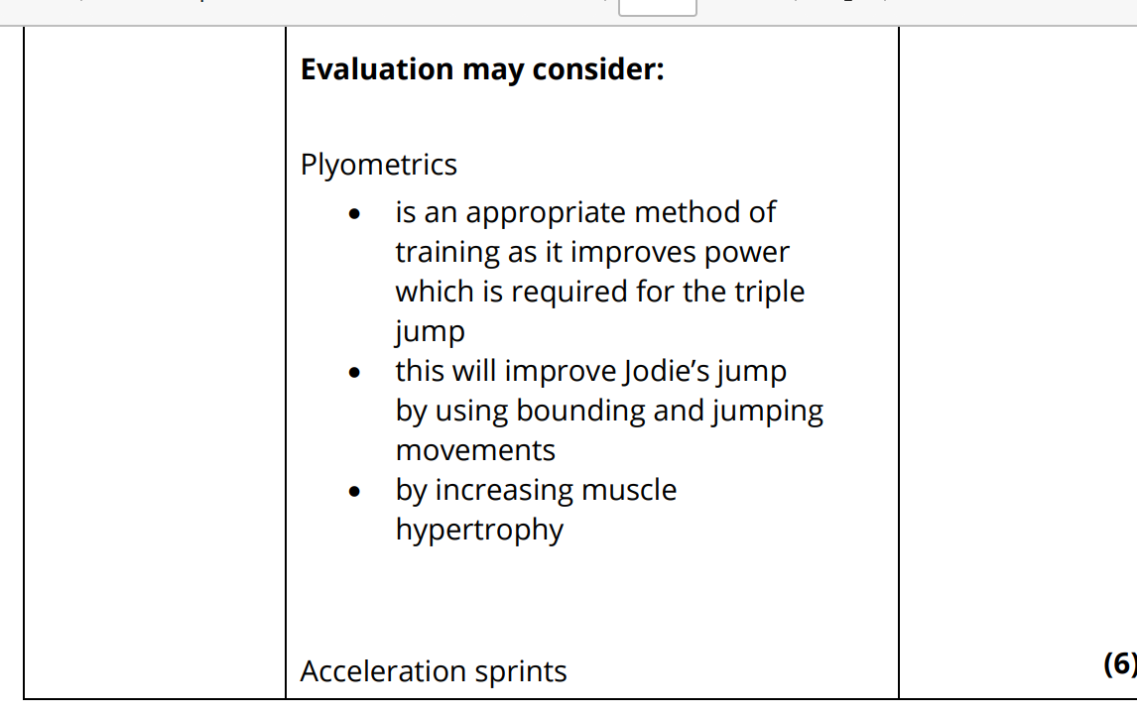
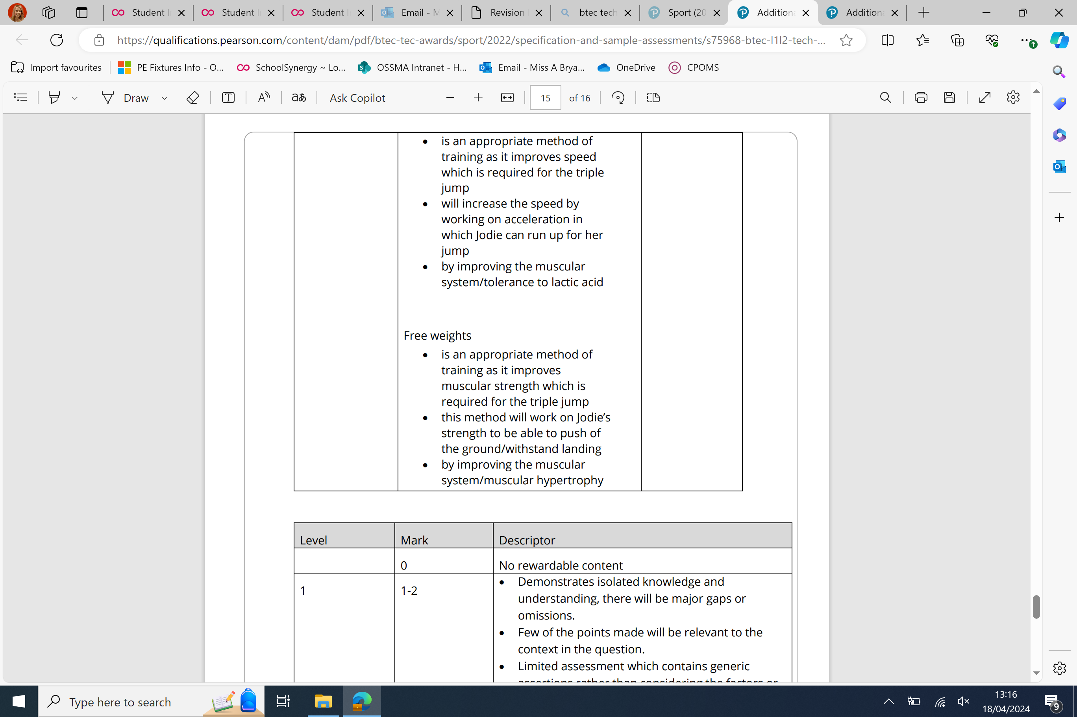
Mark scheme

Slide 46

Example question

Slide 47
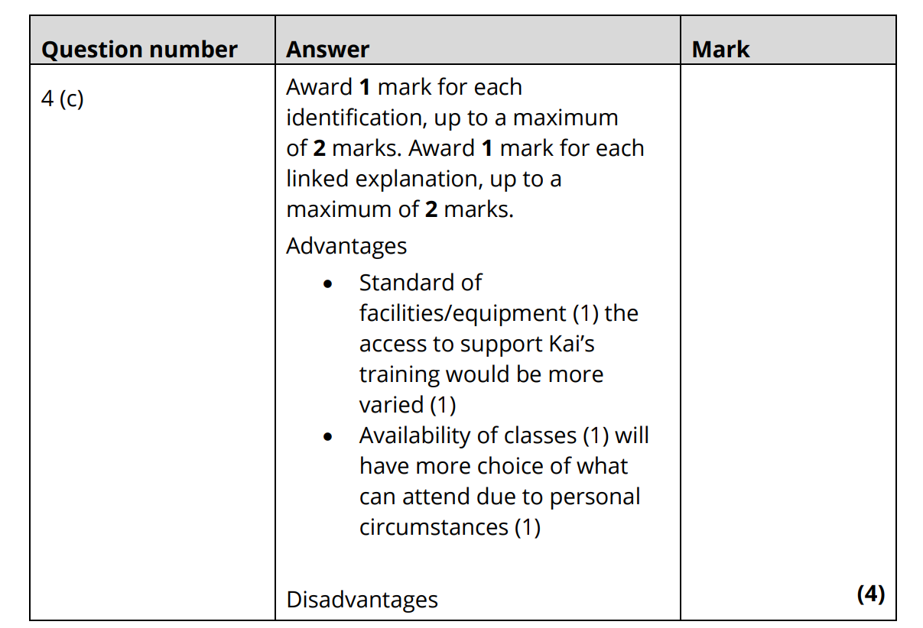
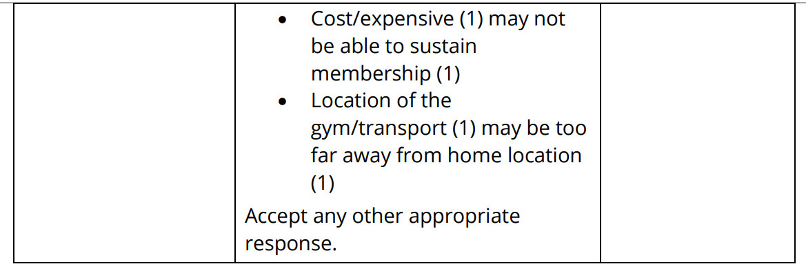
Mark scheme

