Slide 1
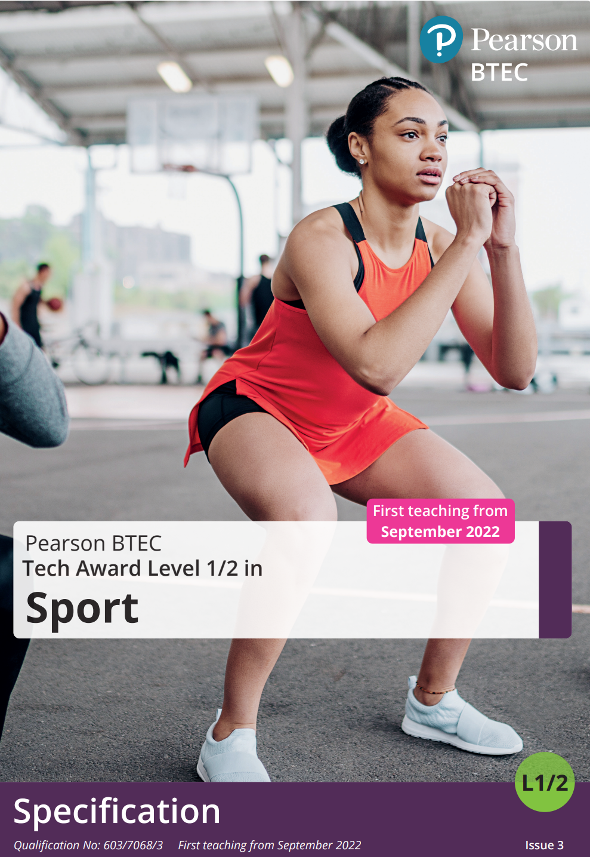

BTEC Sport Tech Award
Component 3
Exam Questions and Mark scheme
Example 2

Slide 2
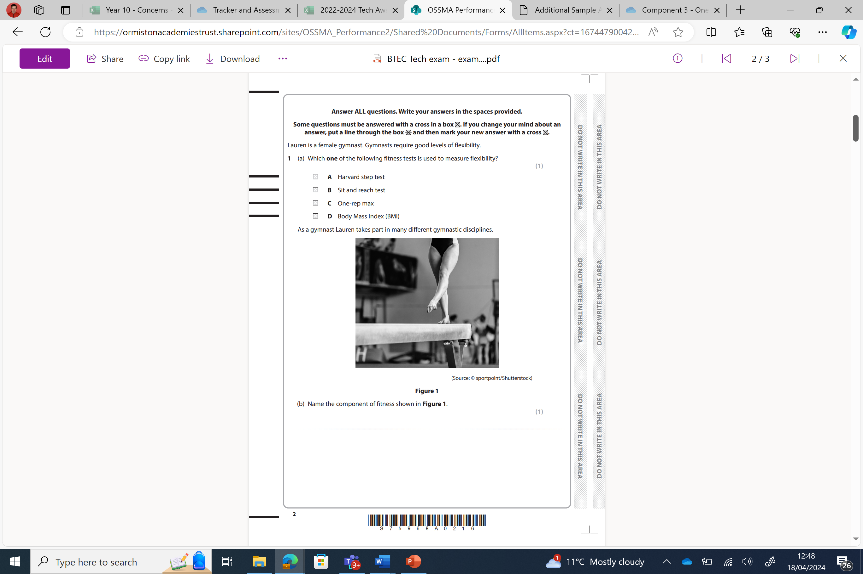
Question 1 – A+B

Slide 3
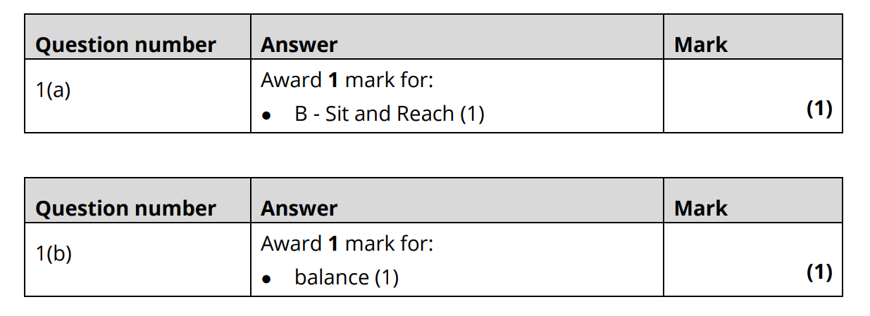
Question 1 – A+B
Answer

Slide 4
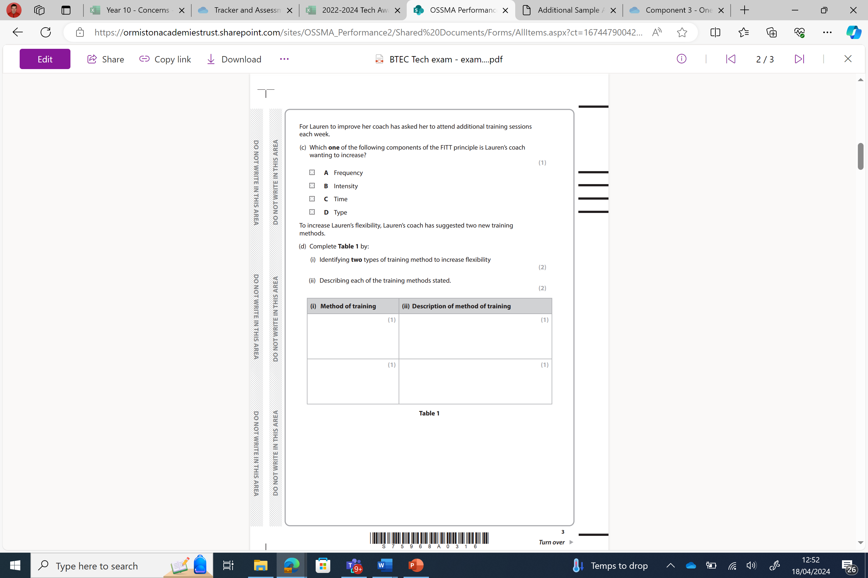
Question 1 – (C+Di+ii)

Slide 5
Question 1 – (C+Di+ii)

Slide 6
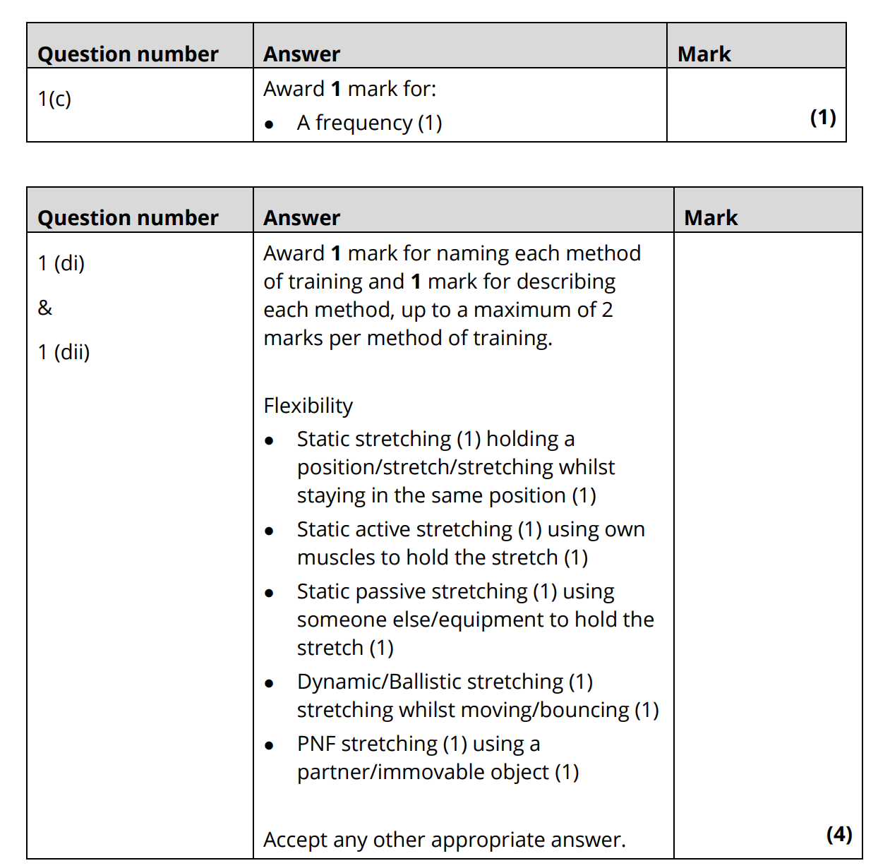
Question 1 – (C+Di+ii)

Slide 7
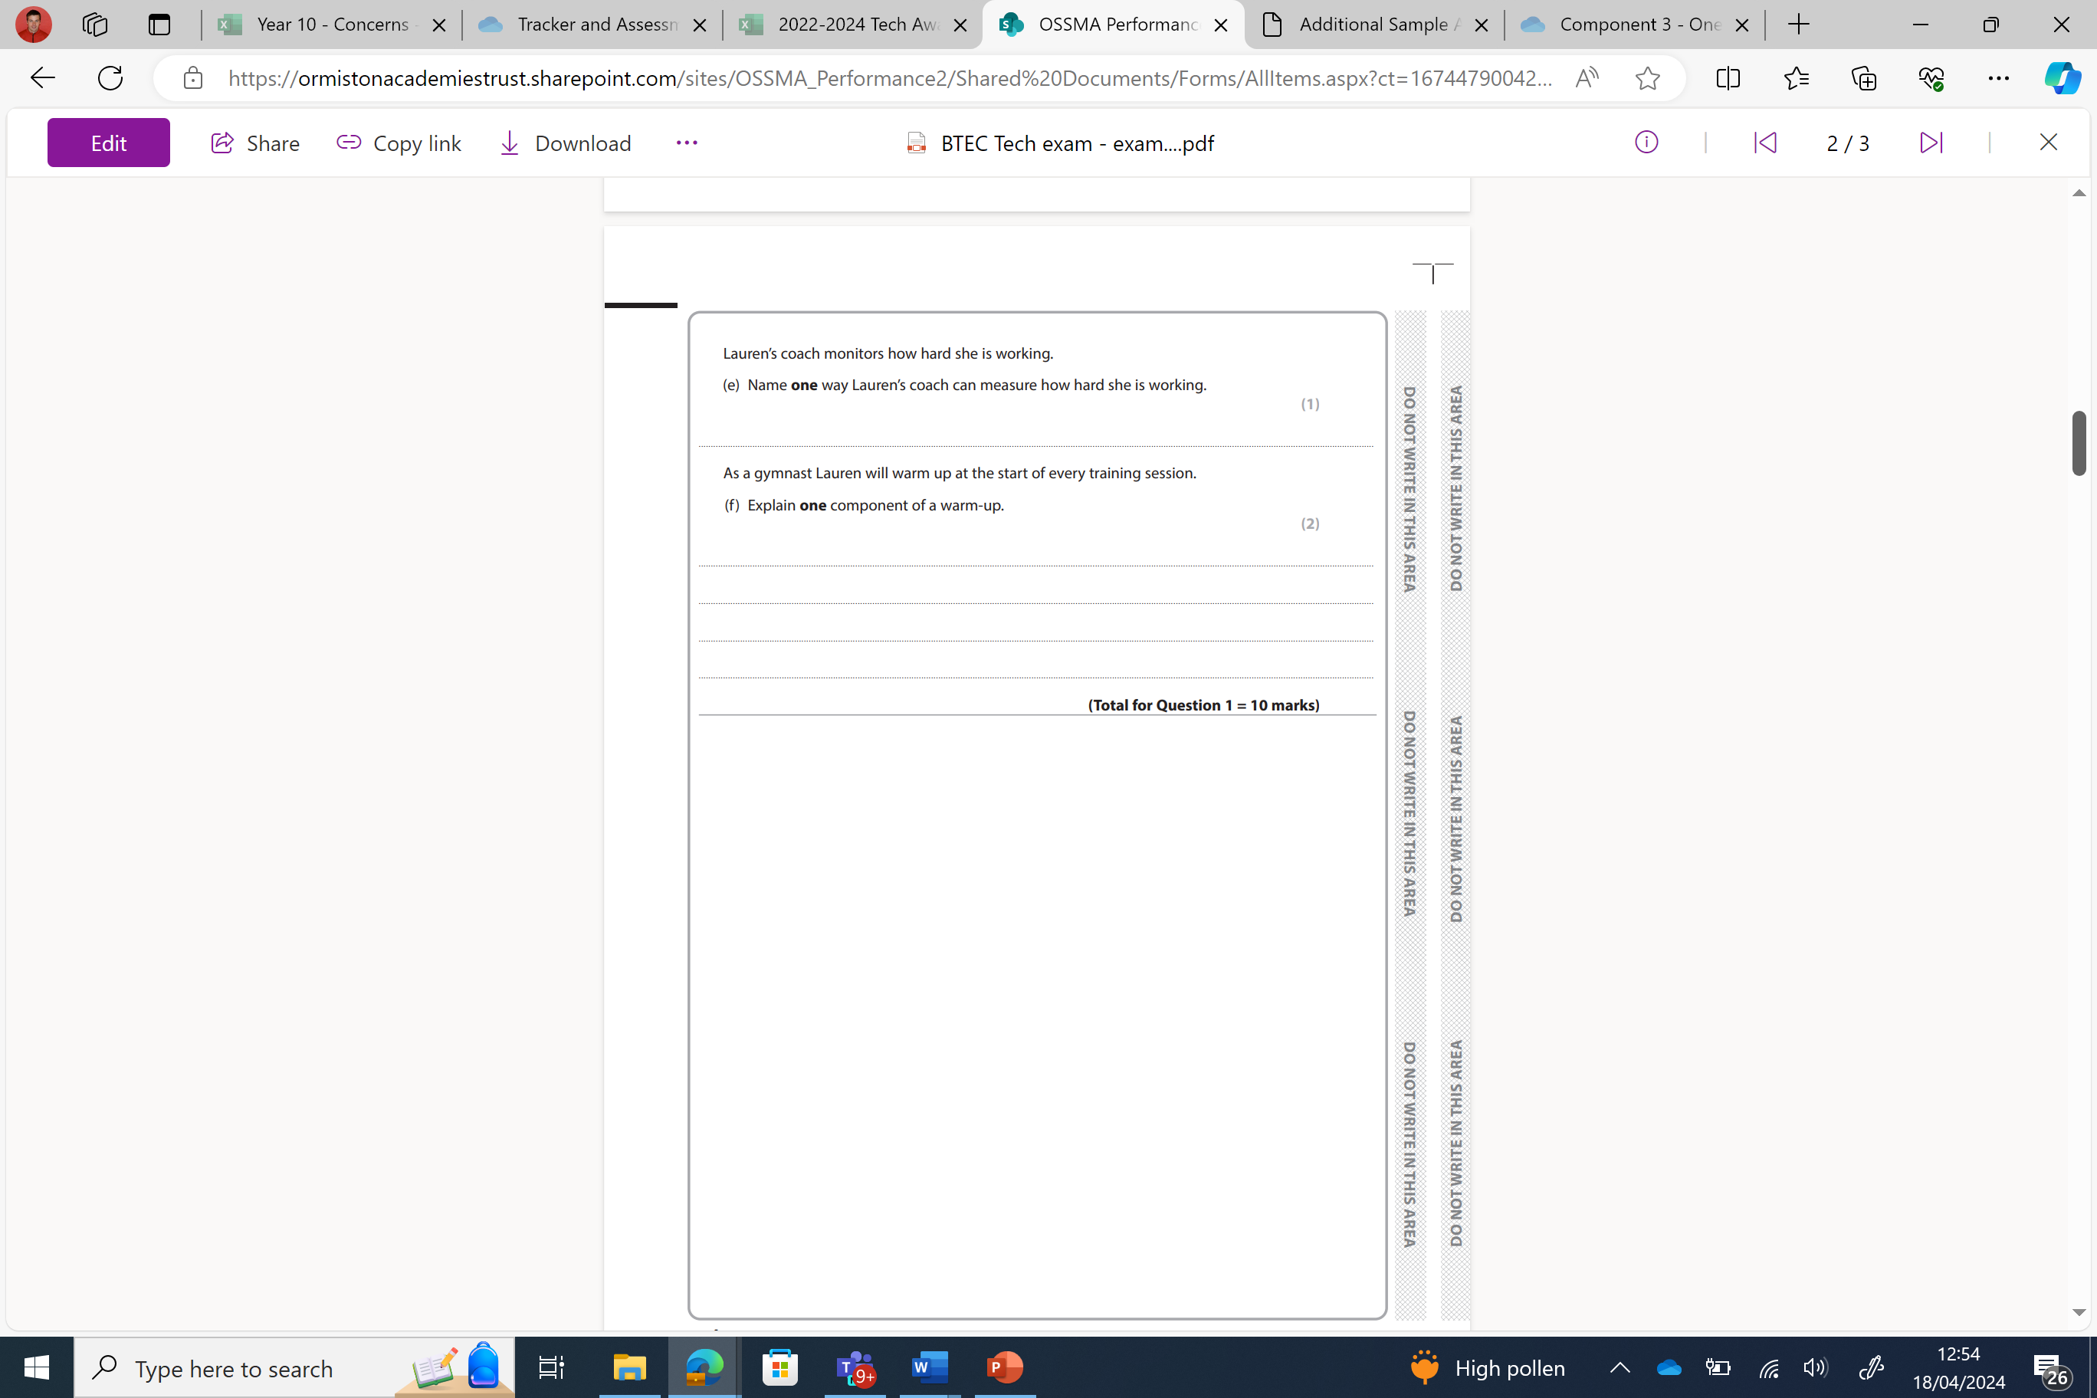
Question 1 - E+F

Slide 8
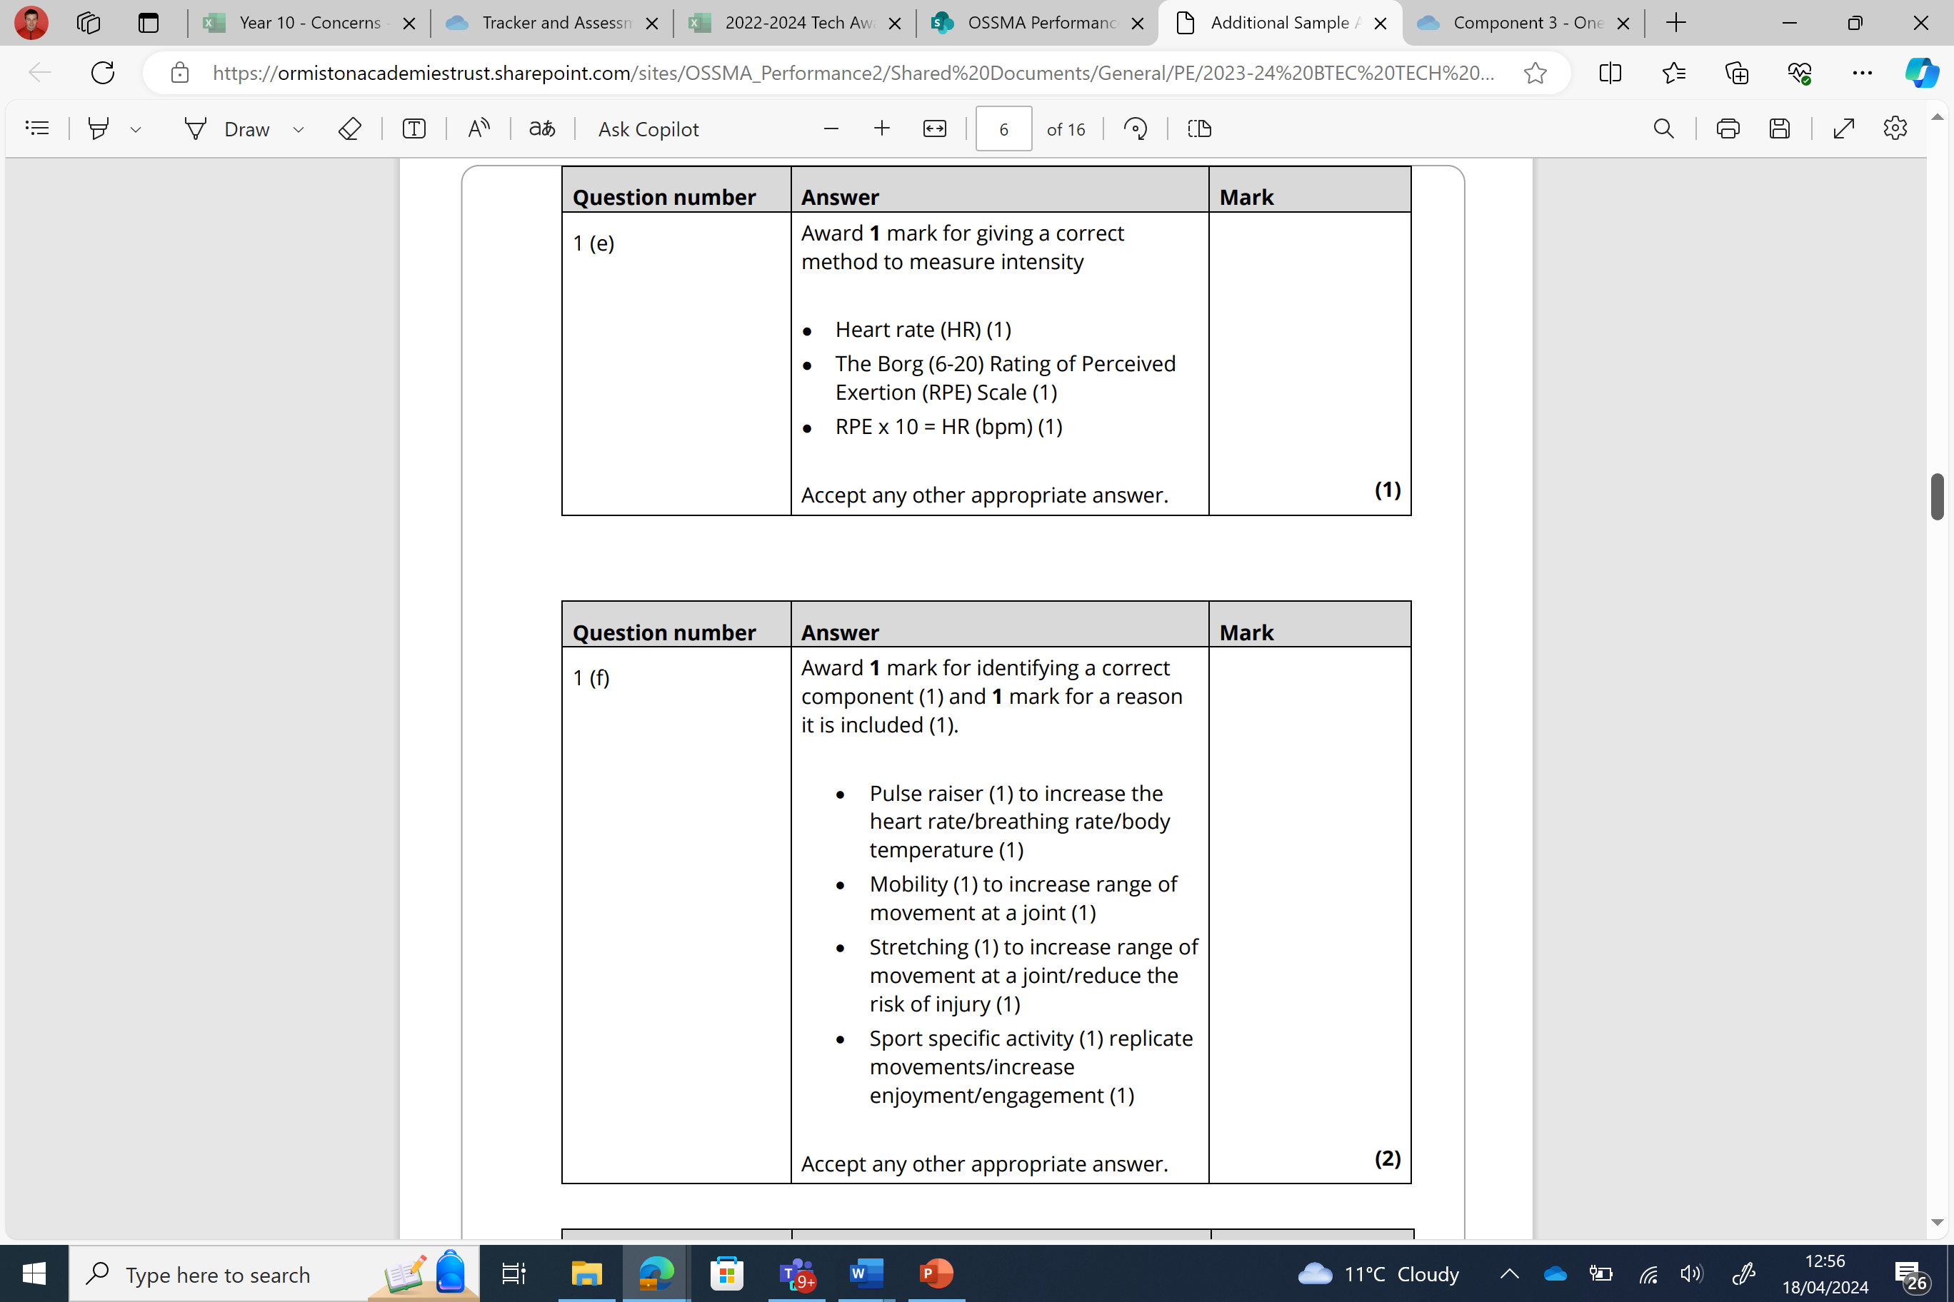
Question 1 - E+F
Answer

Slide 9
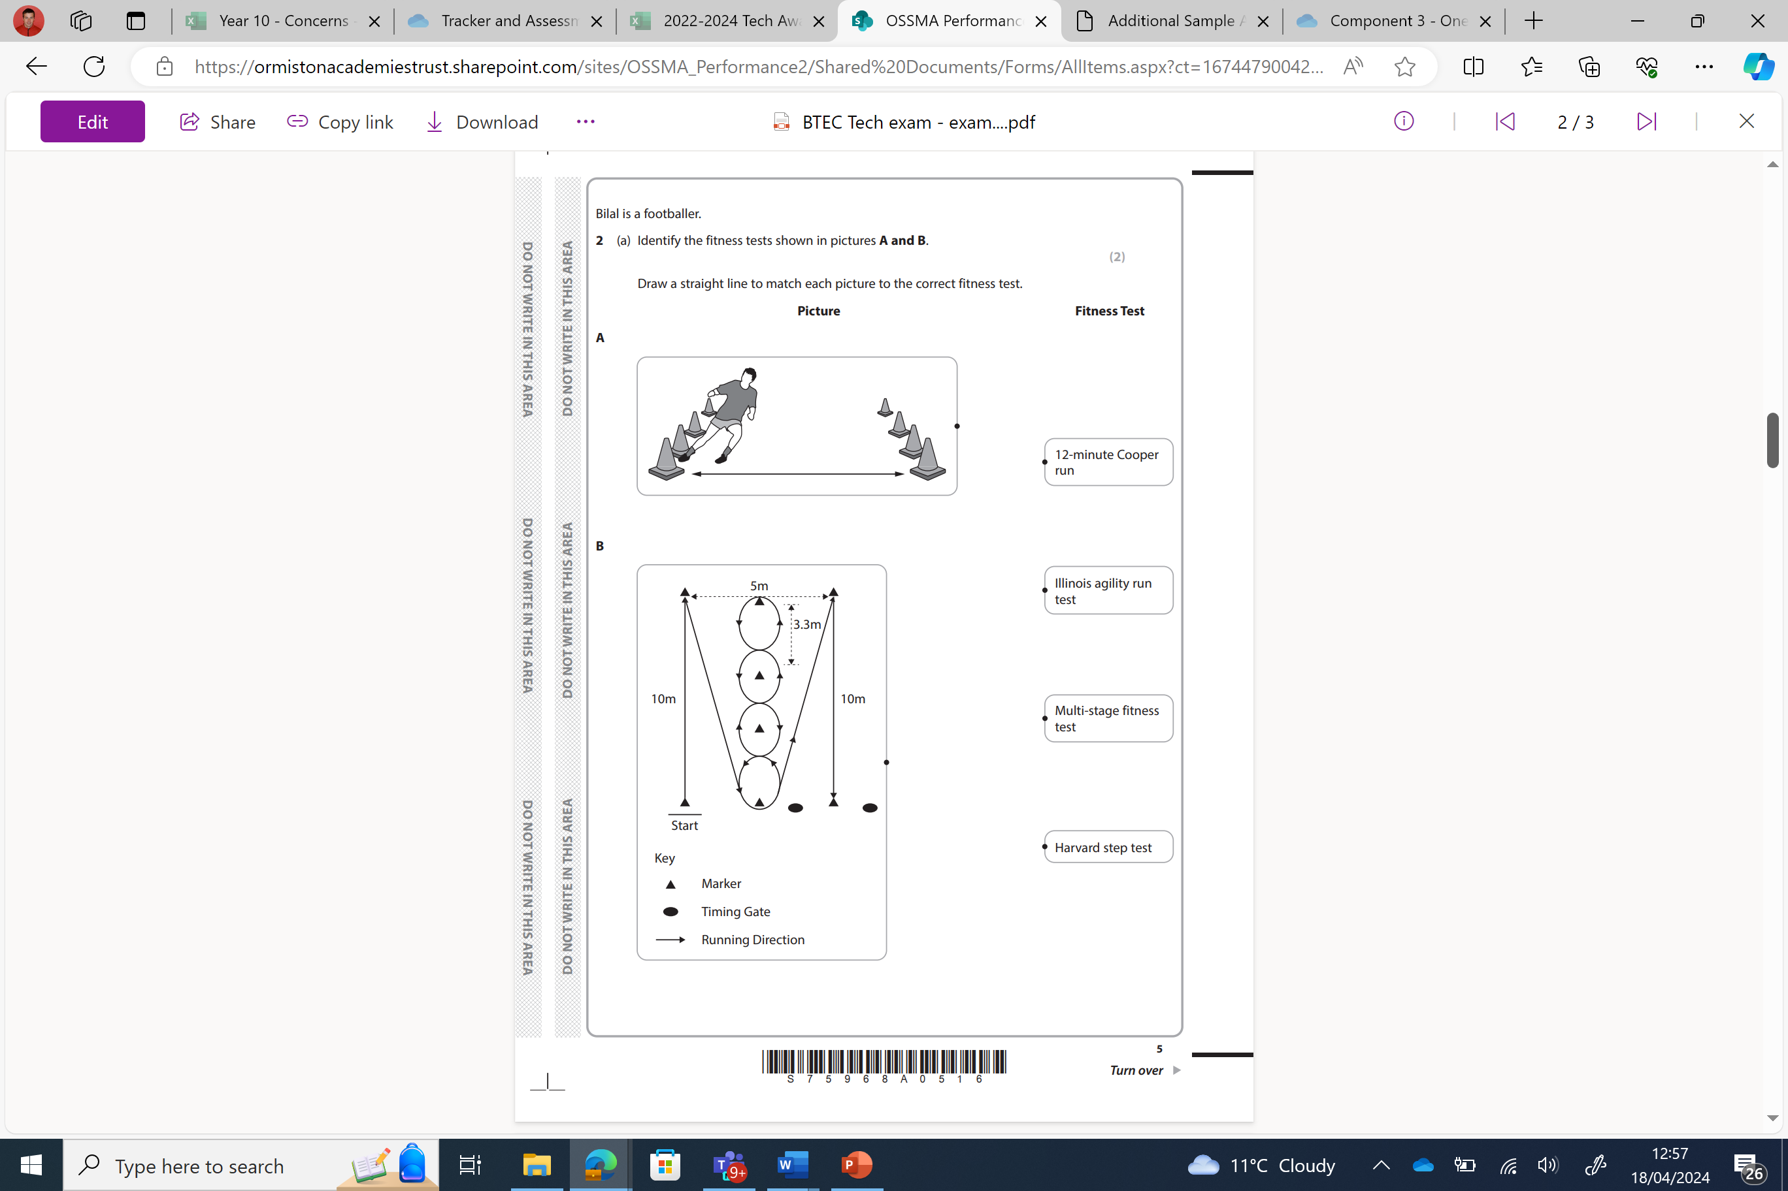
Question 2 – A

Slide 10
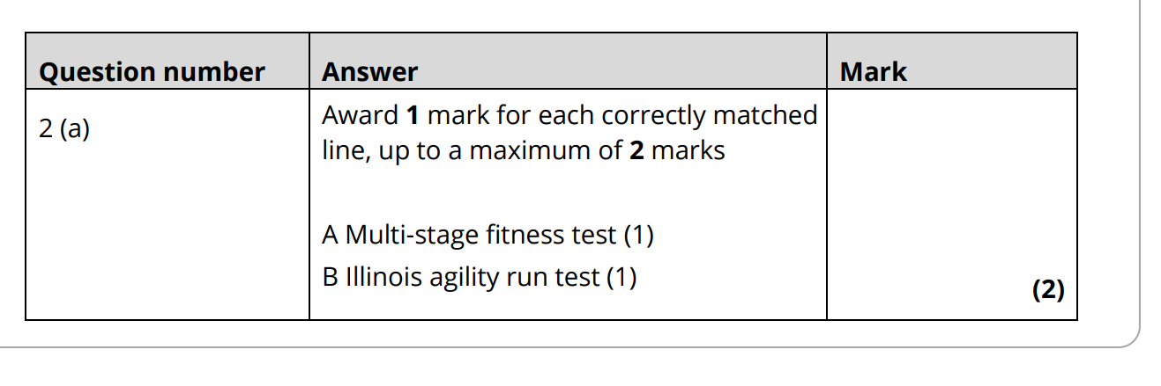
Question 2 – A
Answer

Slide 11
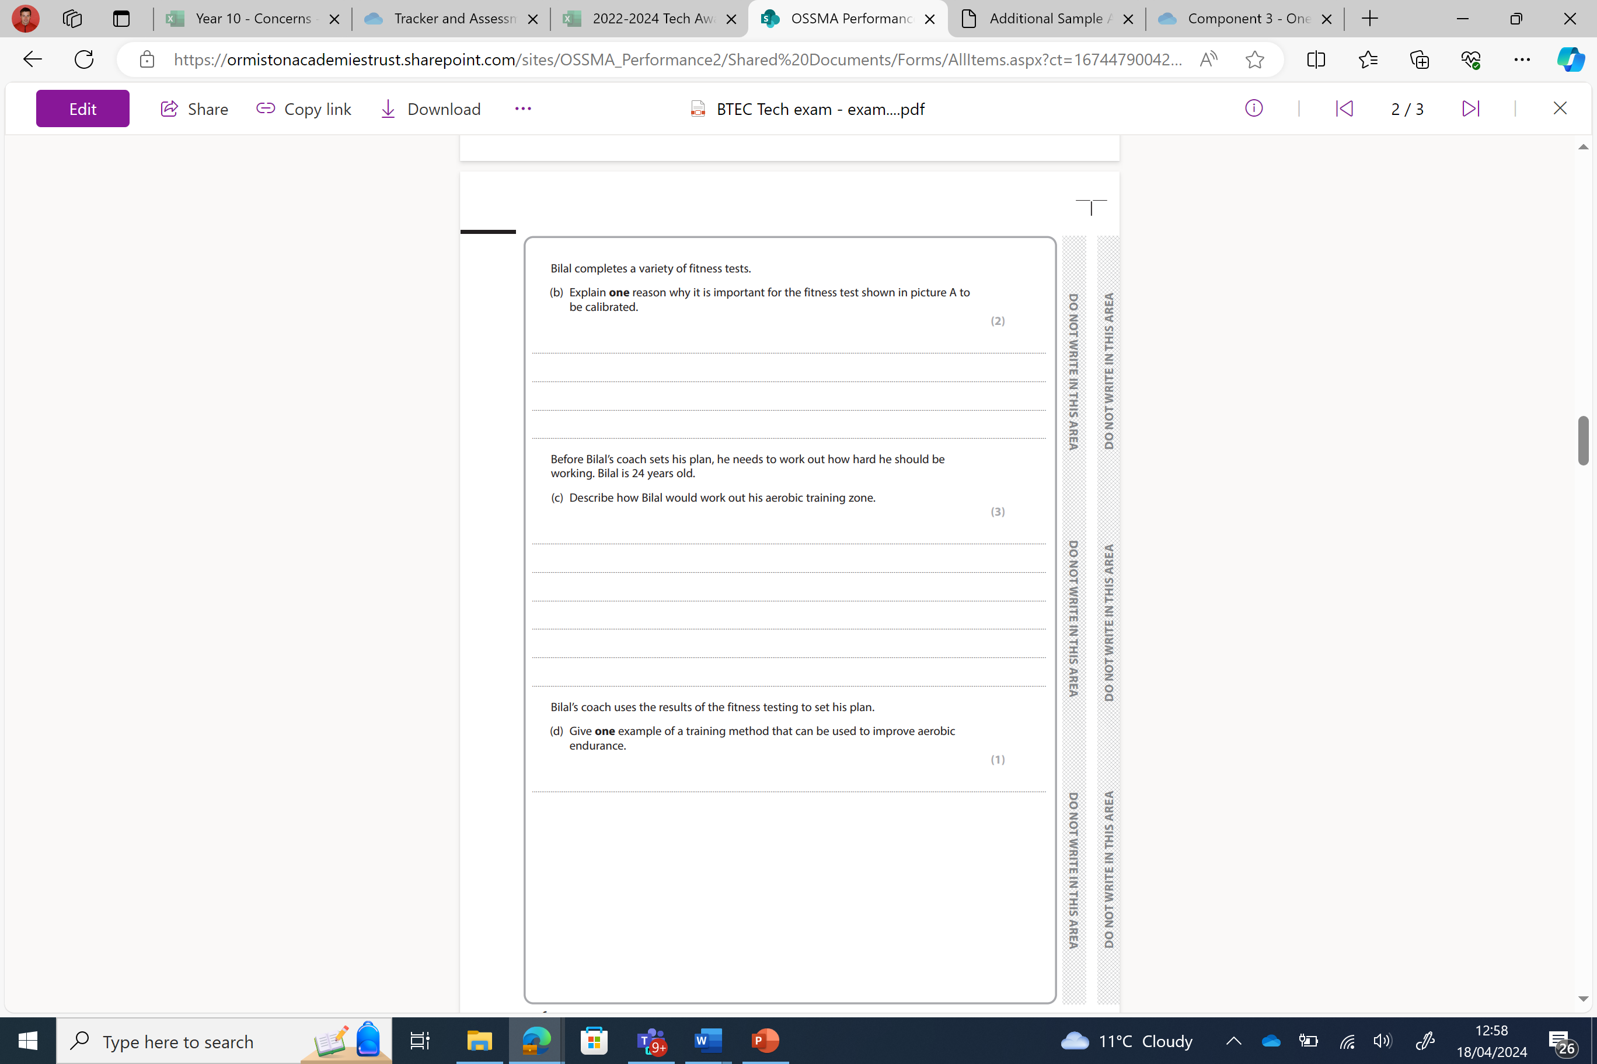
Question 2 – B, C +D

Slide 12
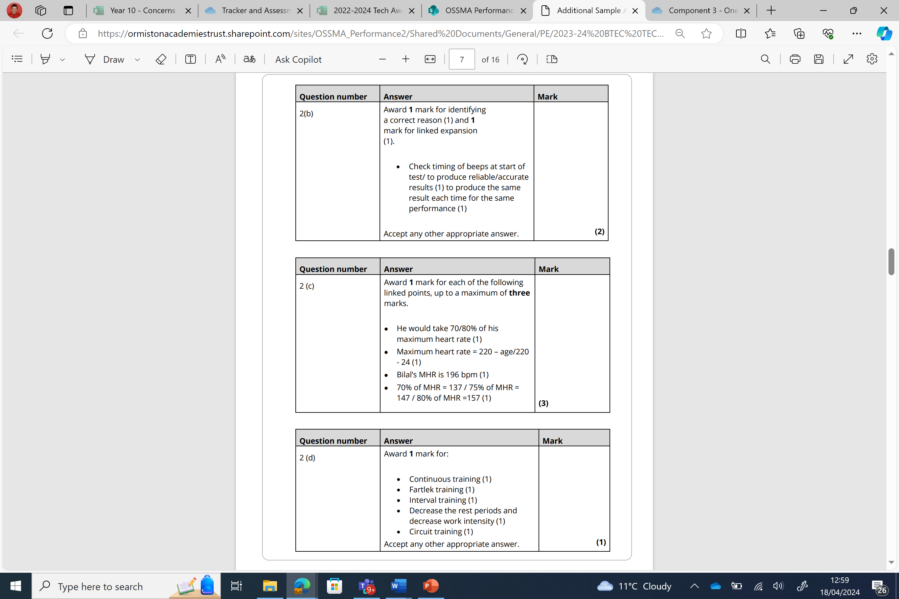
Question 2 – B, C +D
Answer

Slide 13
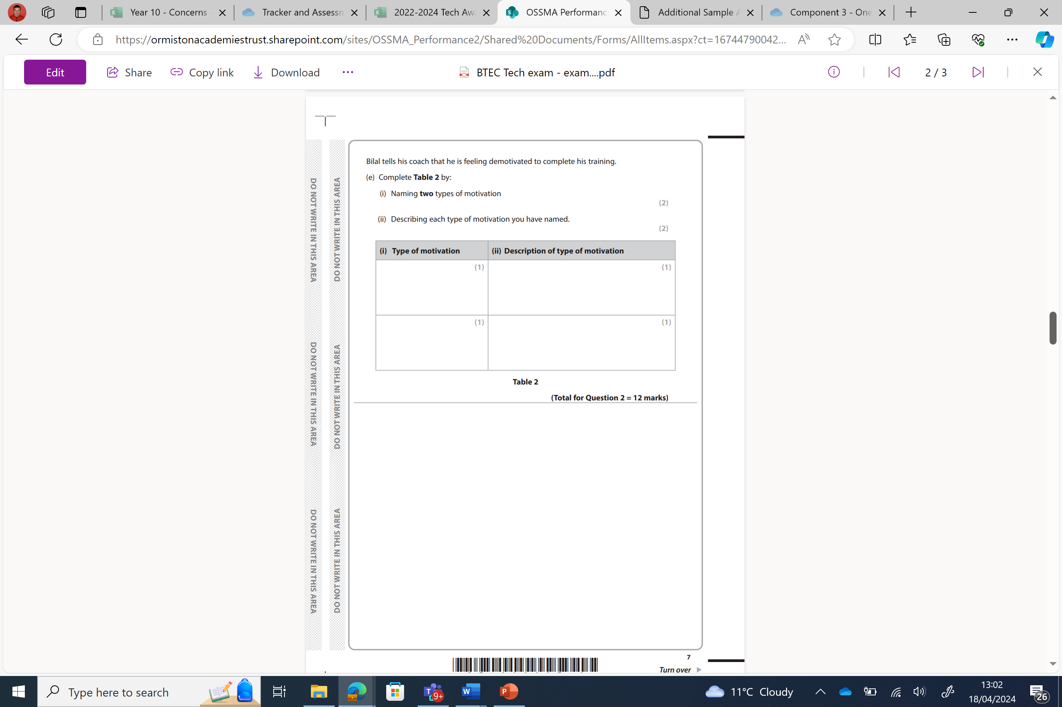
Question 2 – E i+ii
Answer

Slide 14
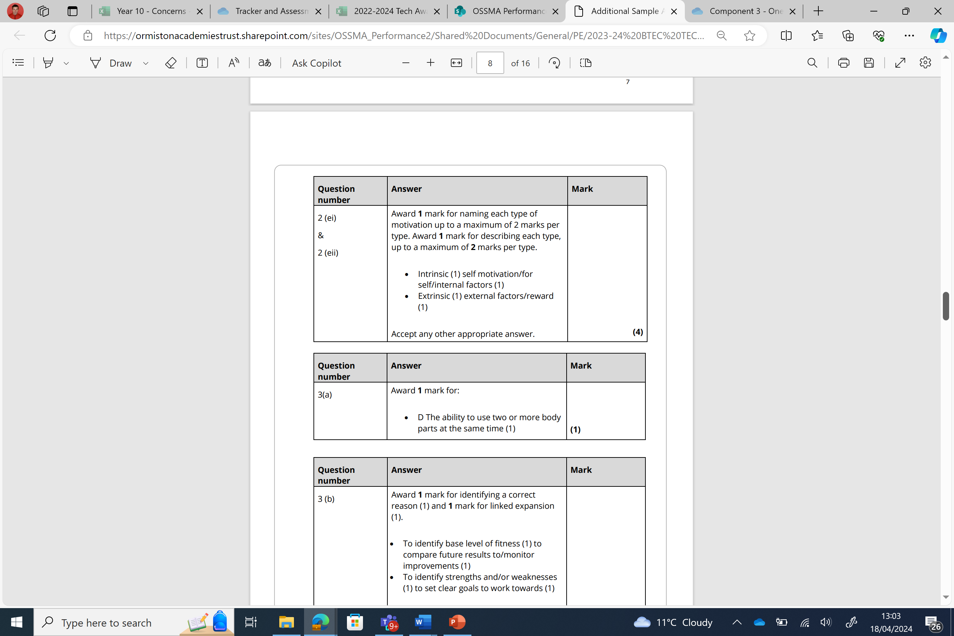
Question 2 – E i+ii
Answer

Slide 15
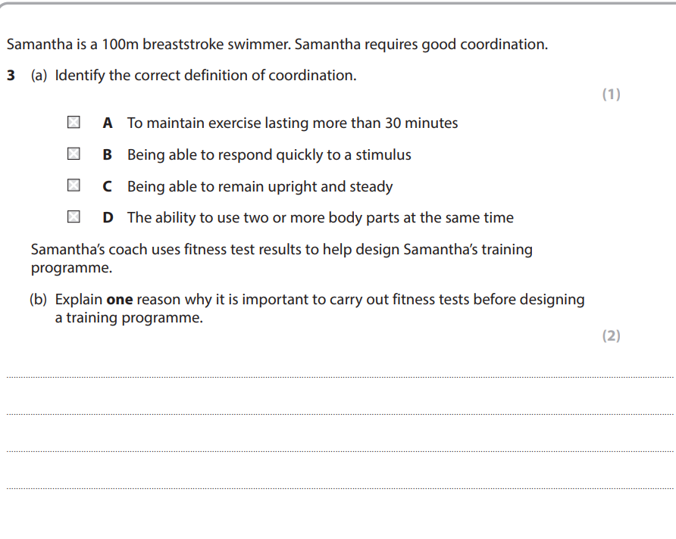
Question 3 – A+B
Answer

Slide 16
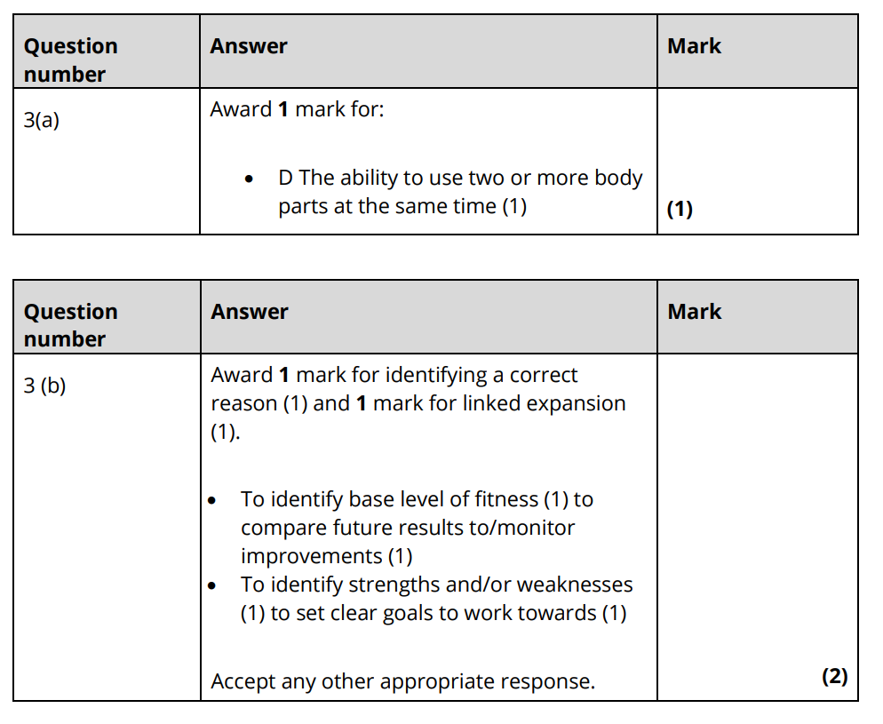
Question 3 – A+B
Answer

Slide 17
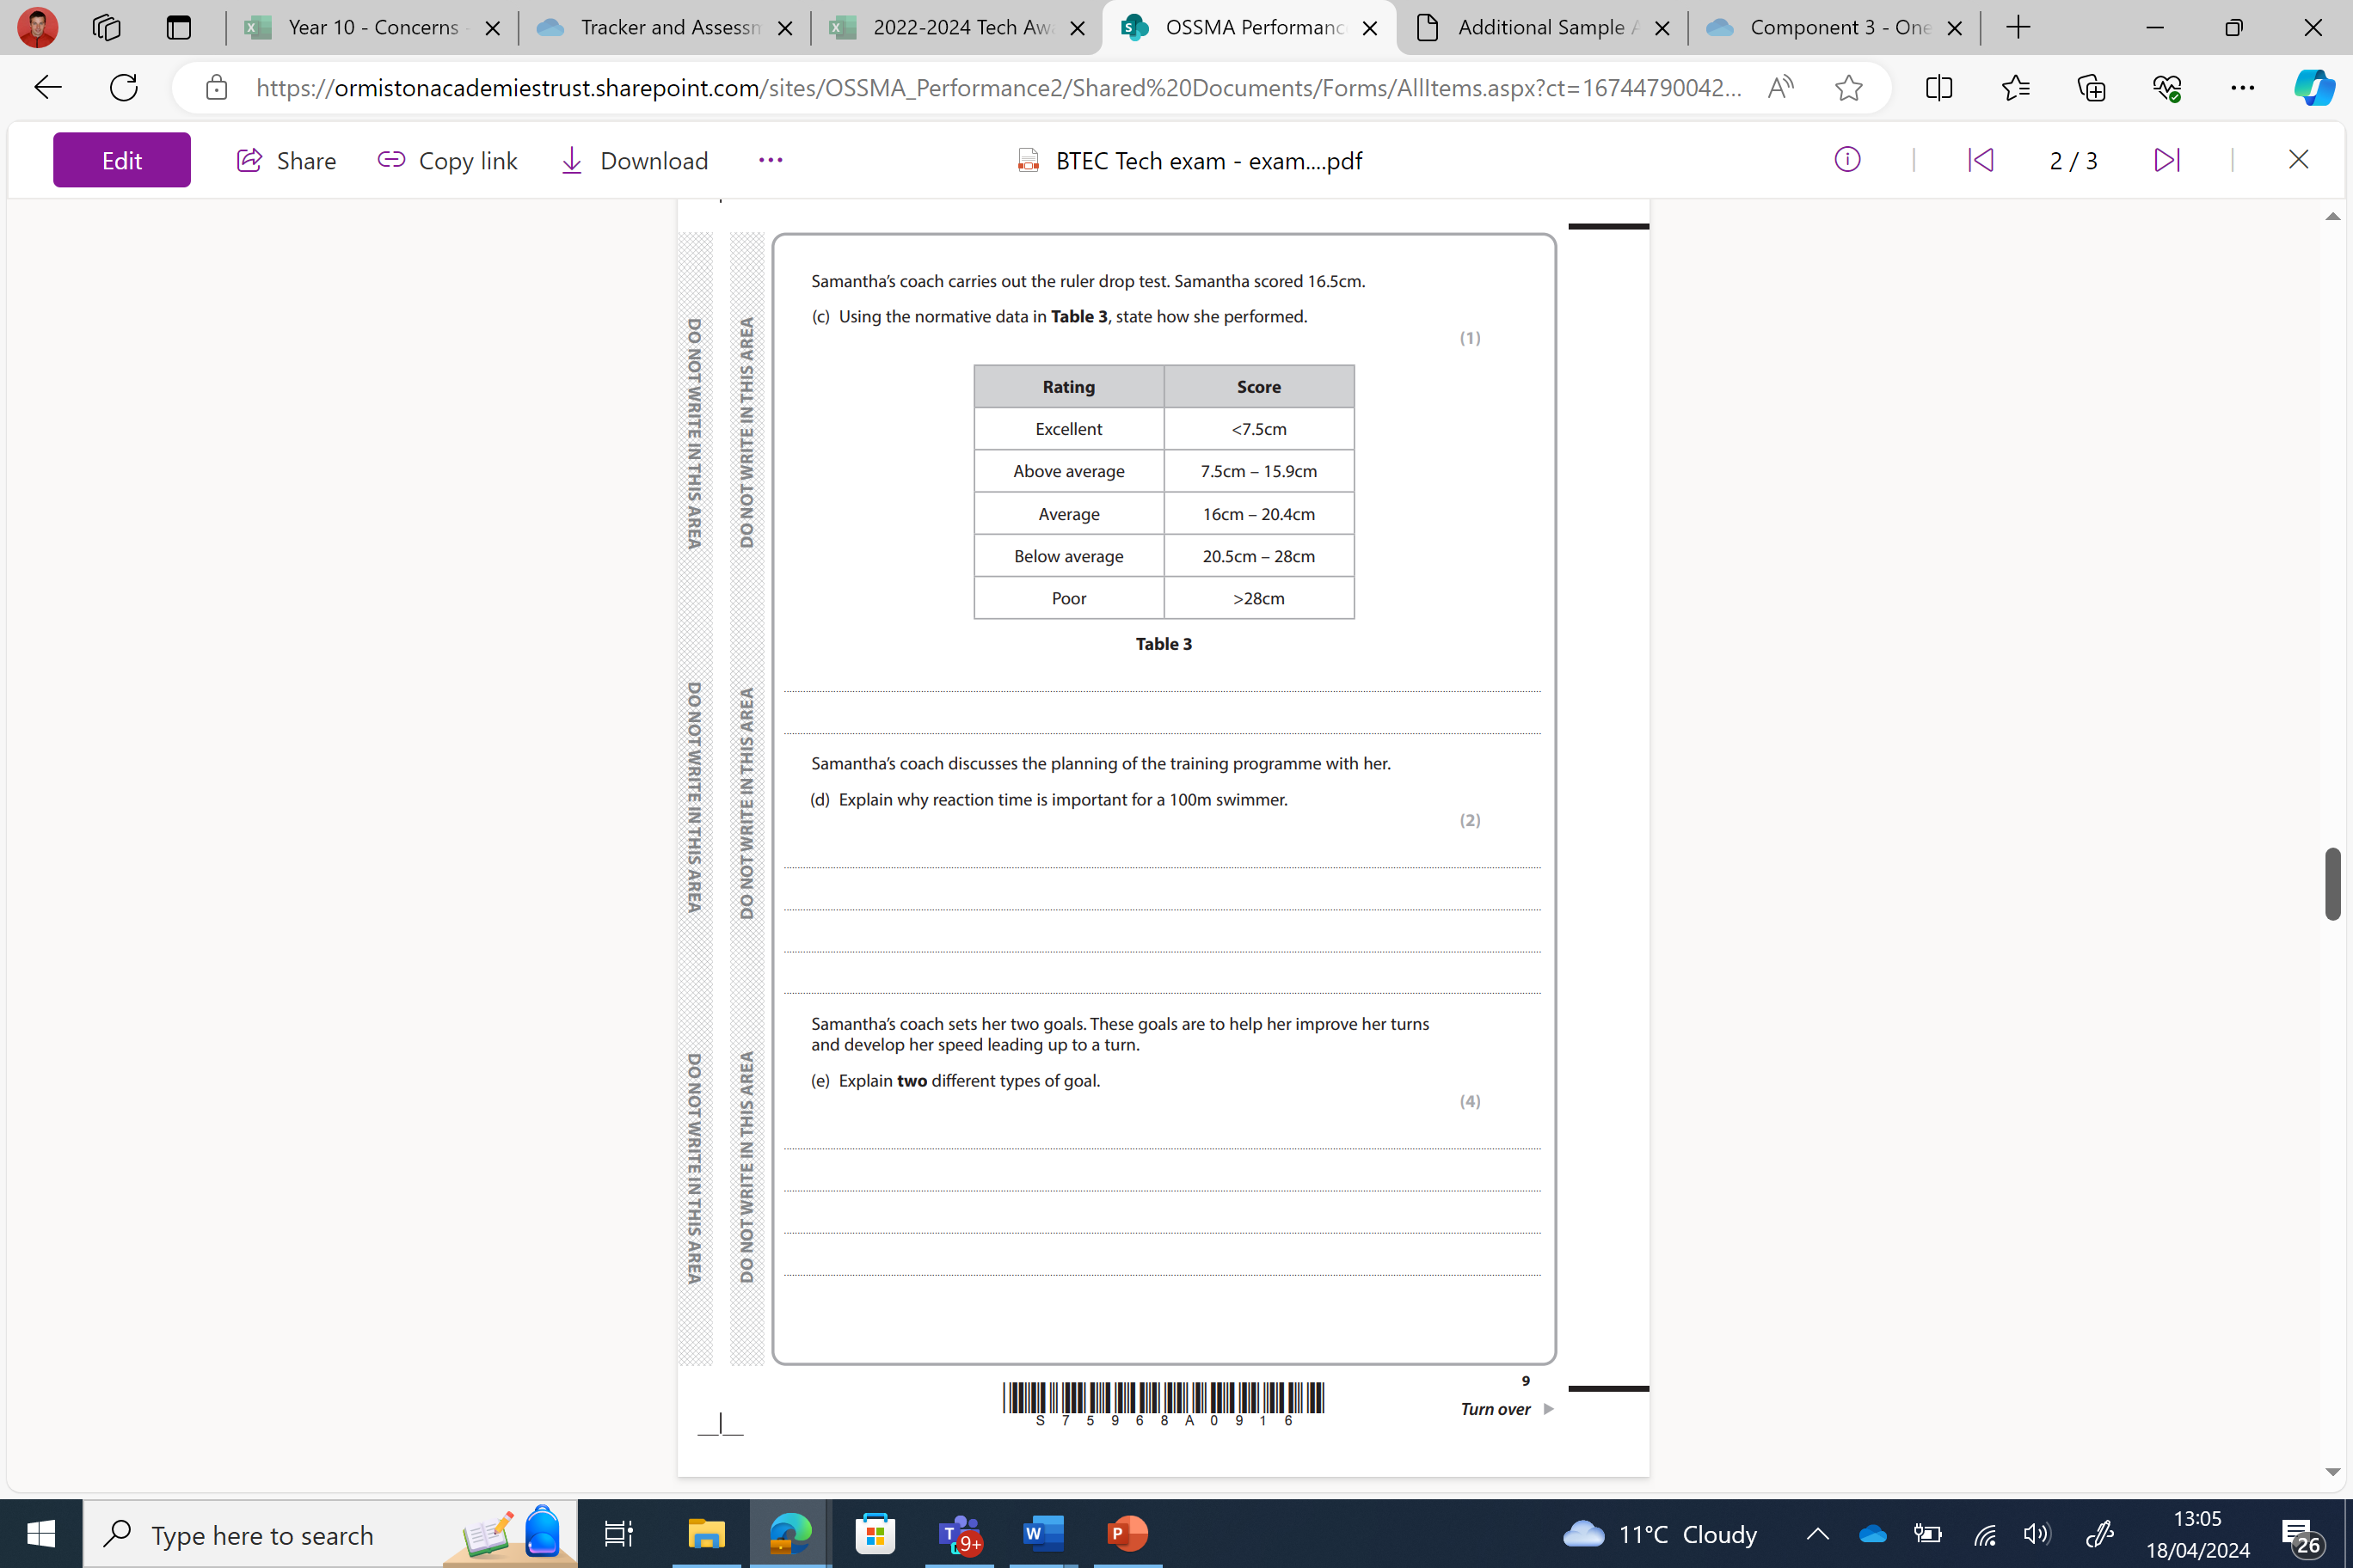
Question 3 – C, D +E
Answer

Slide 18
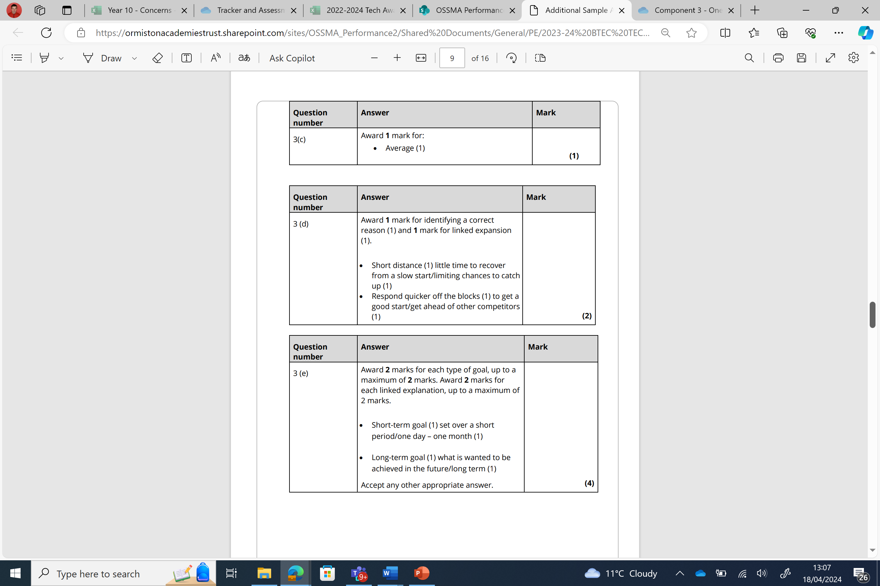
Question 3 – C, D +E
Answer

Slide 19
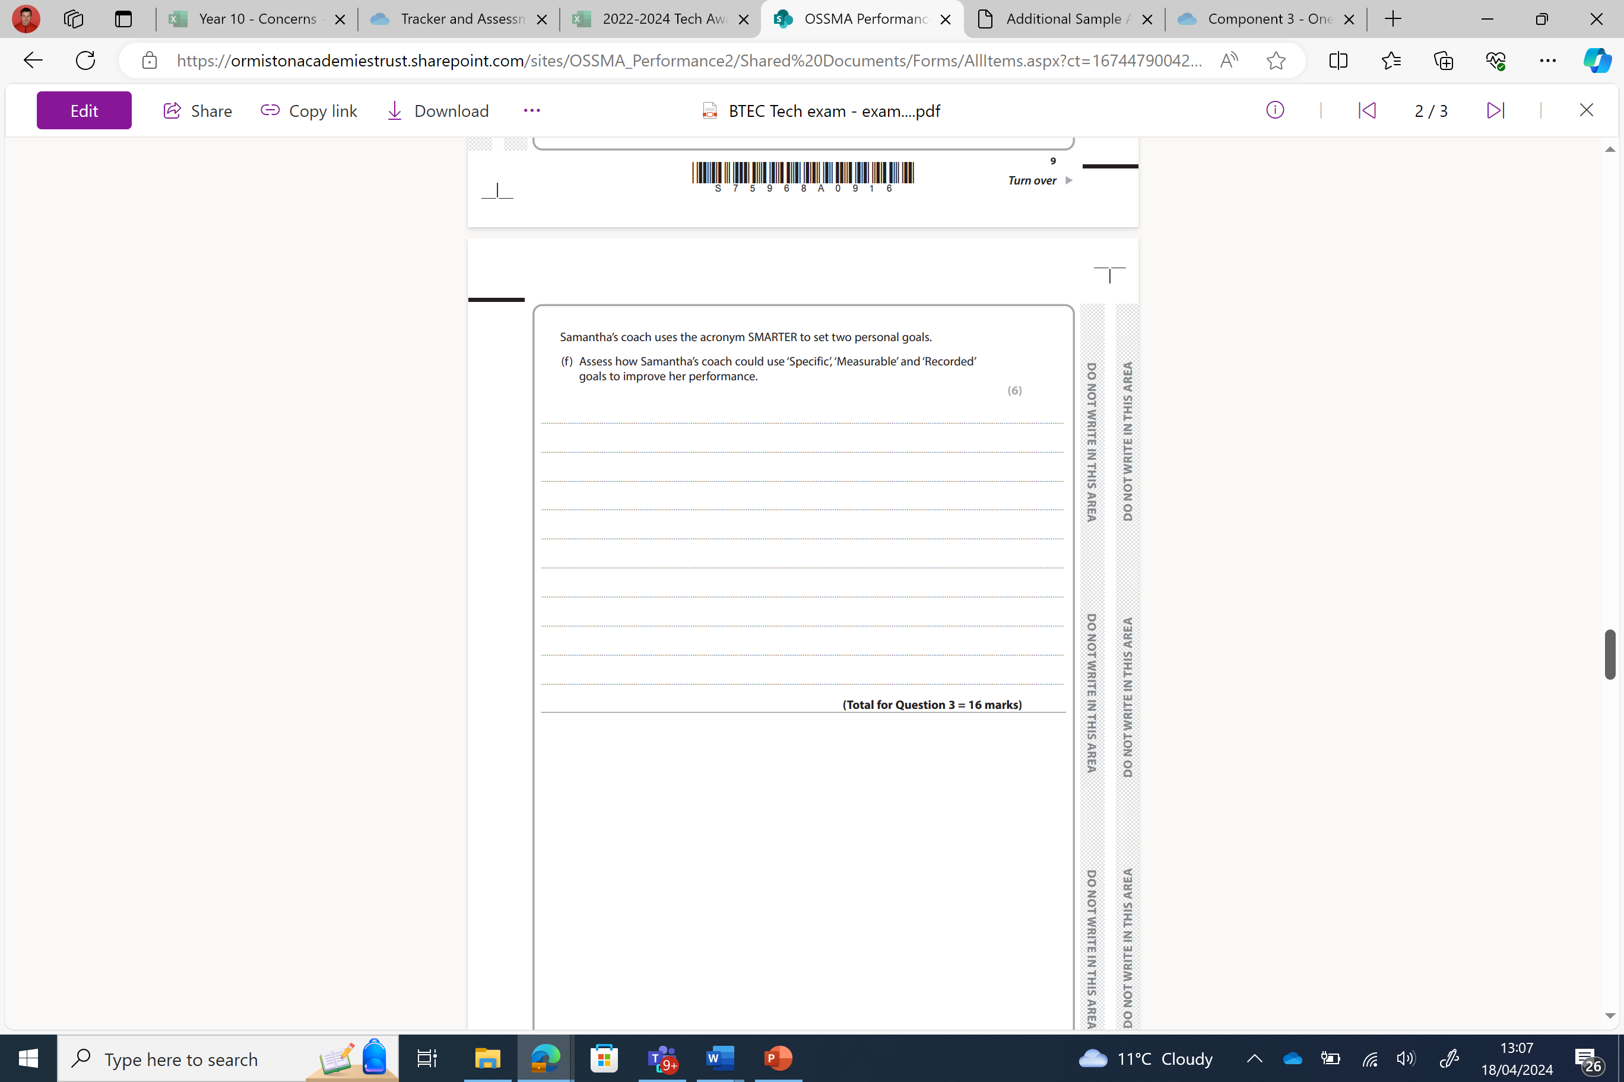
Question 3 – F
Answer

Slide 20
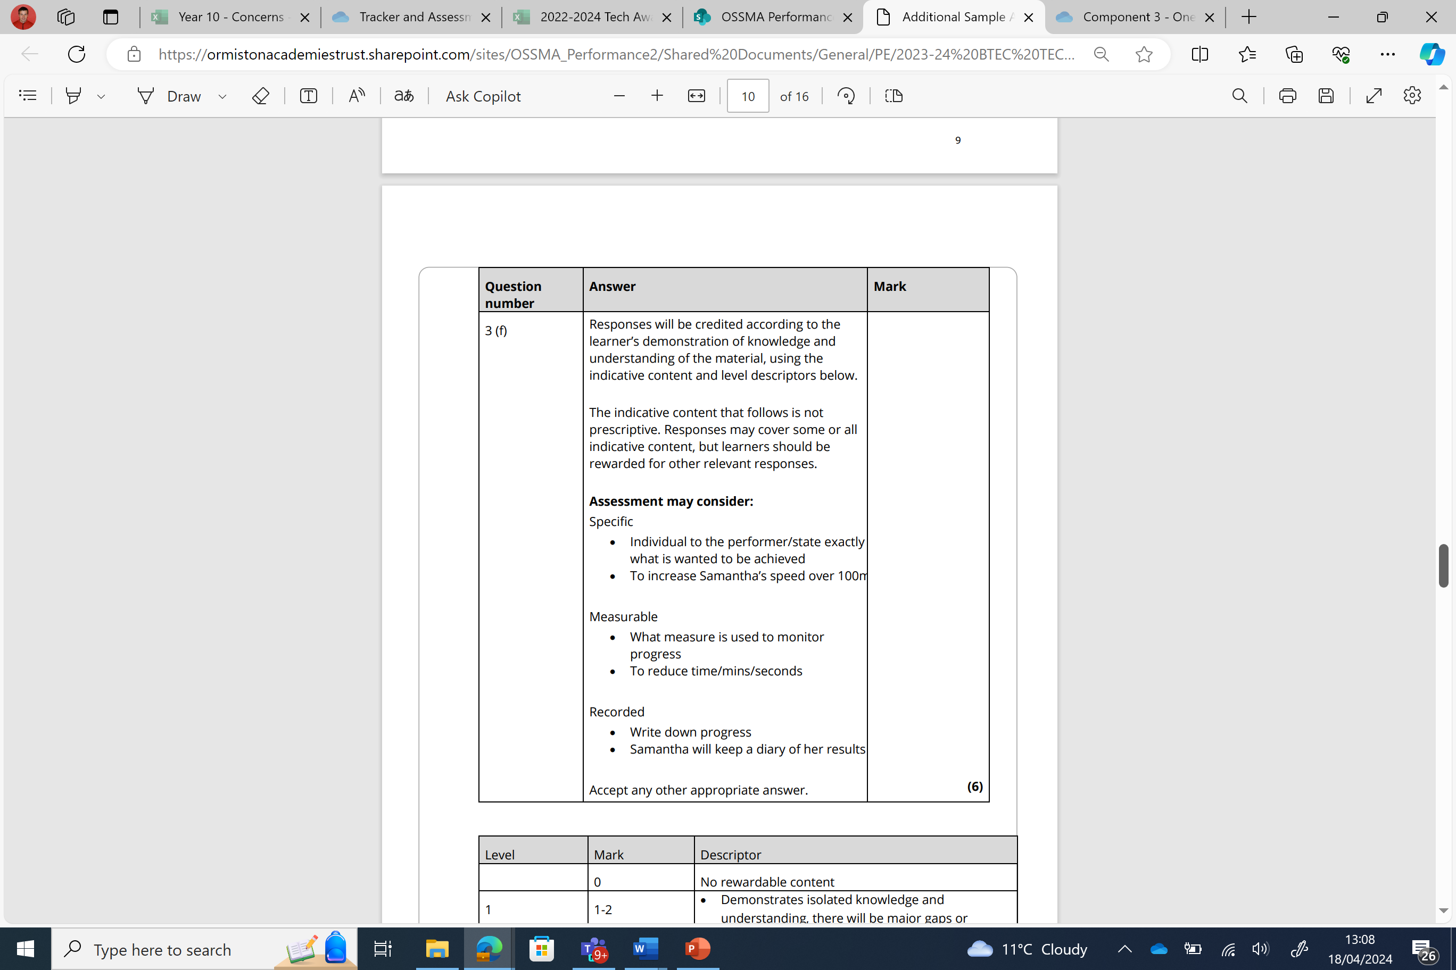
Question 3 – F
Answer

Slide 21
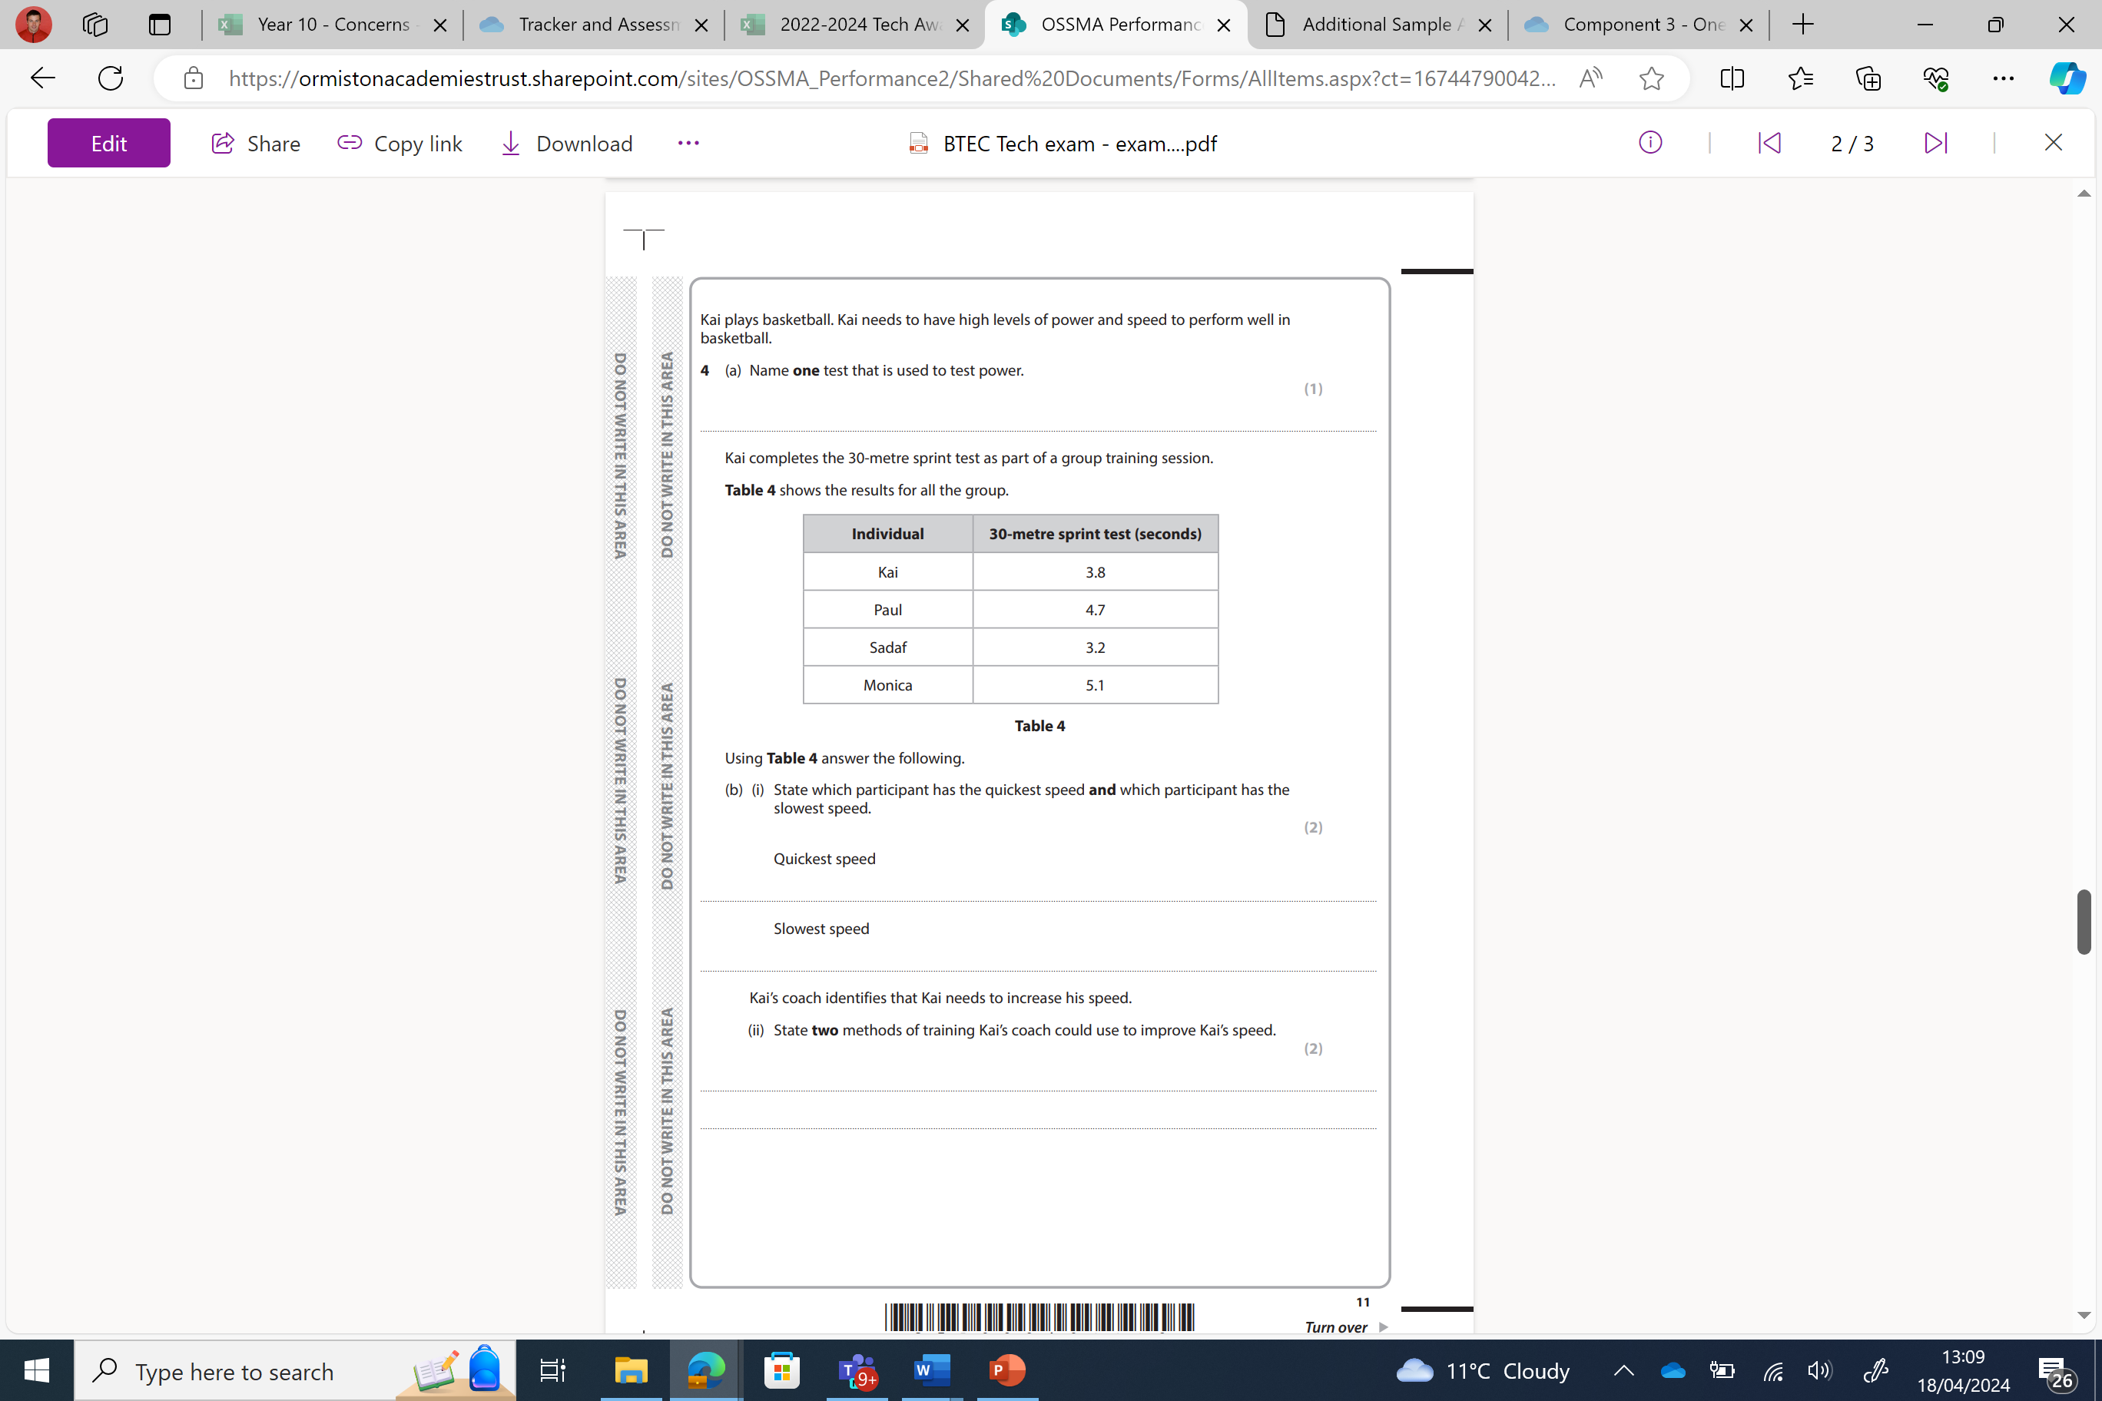
Question 4 – A, B (i+ii)
Answer

Slide 22
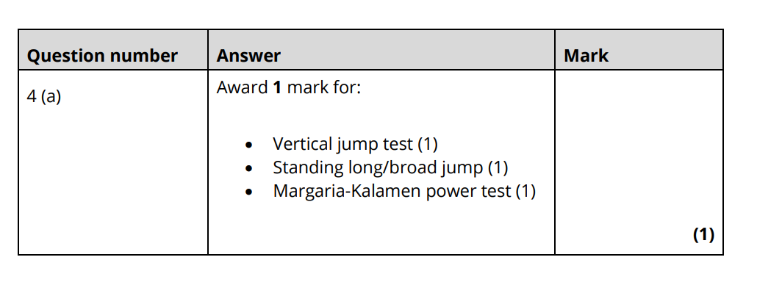
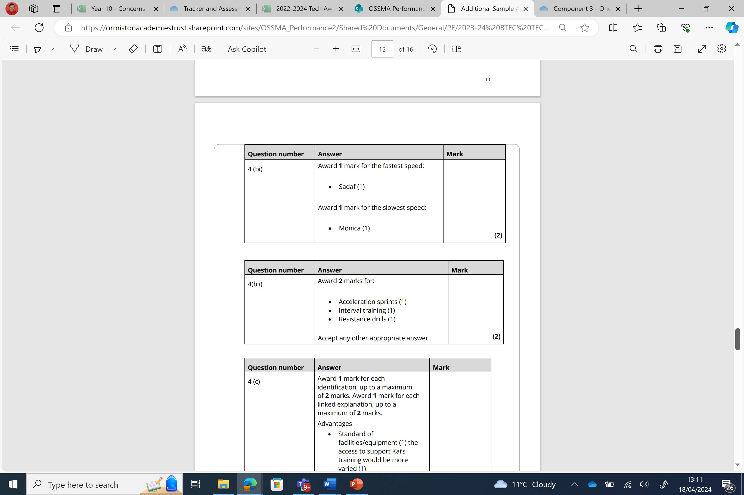
Question 4 – A, B (i+ii)
Answer

Slide 23
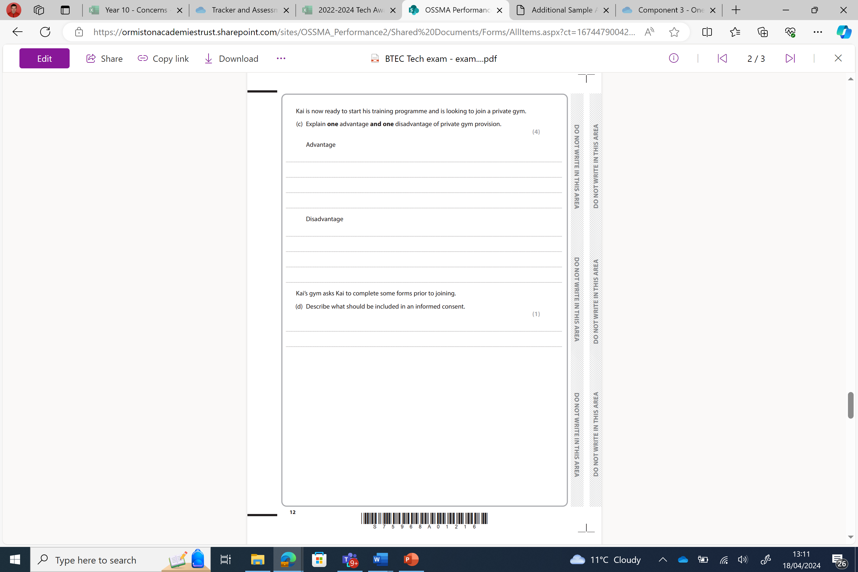
Question 4 – C
Answer

Slide 24
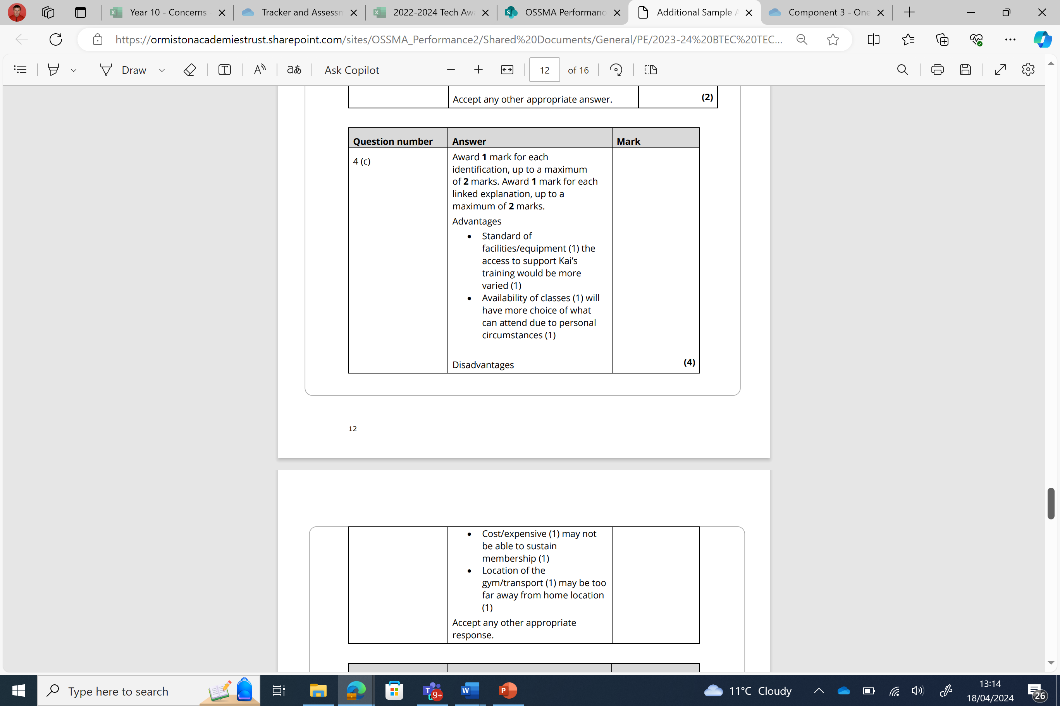
Question 4 – C
Answer

Slide 25
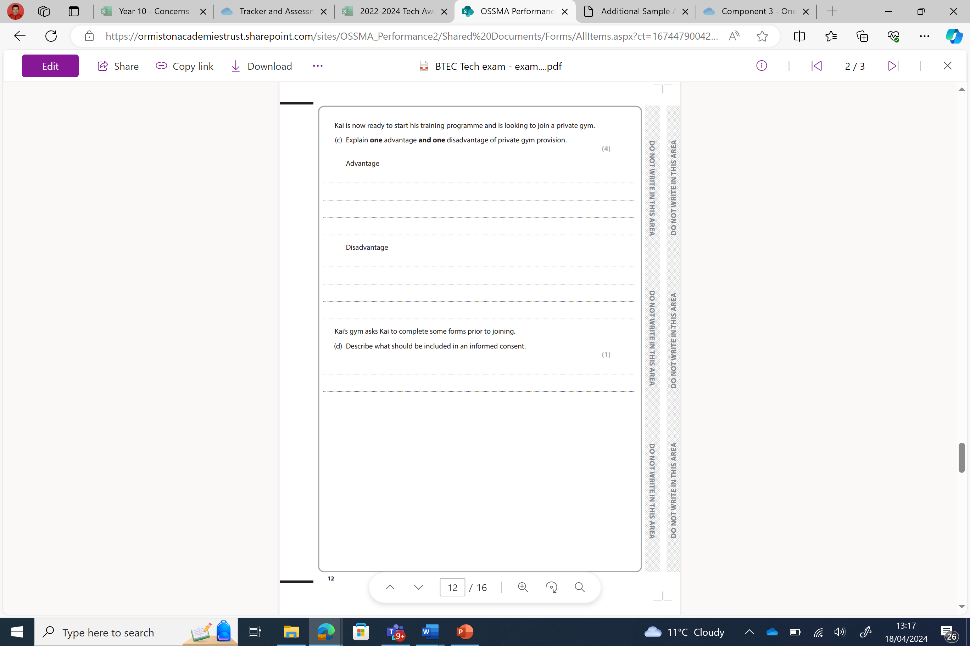
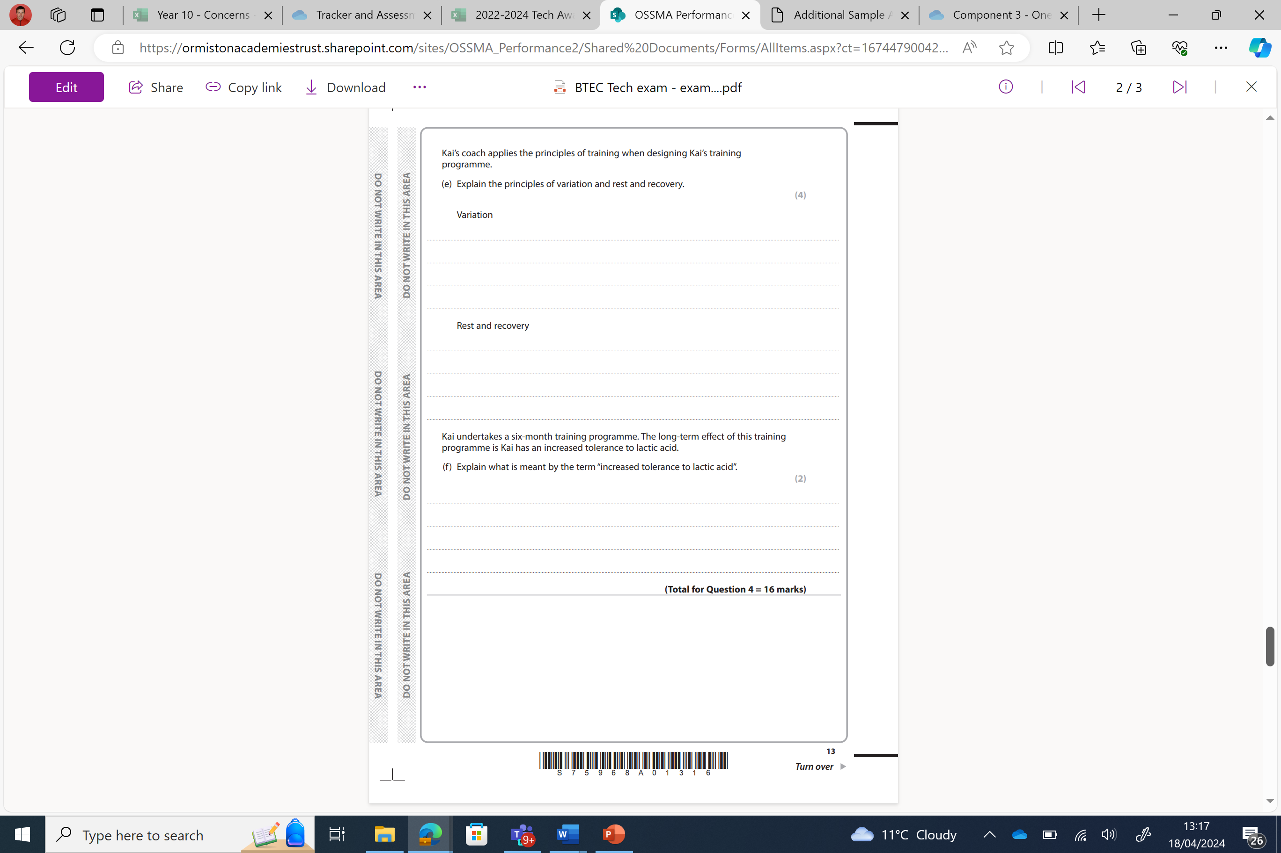
Question 4 – D + E
Answer

Slide 26

Question 4 – D + E
Answer

Slide 27

Question 4 – F
Answer

Slide 28
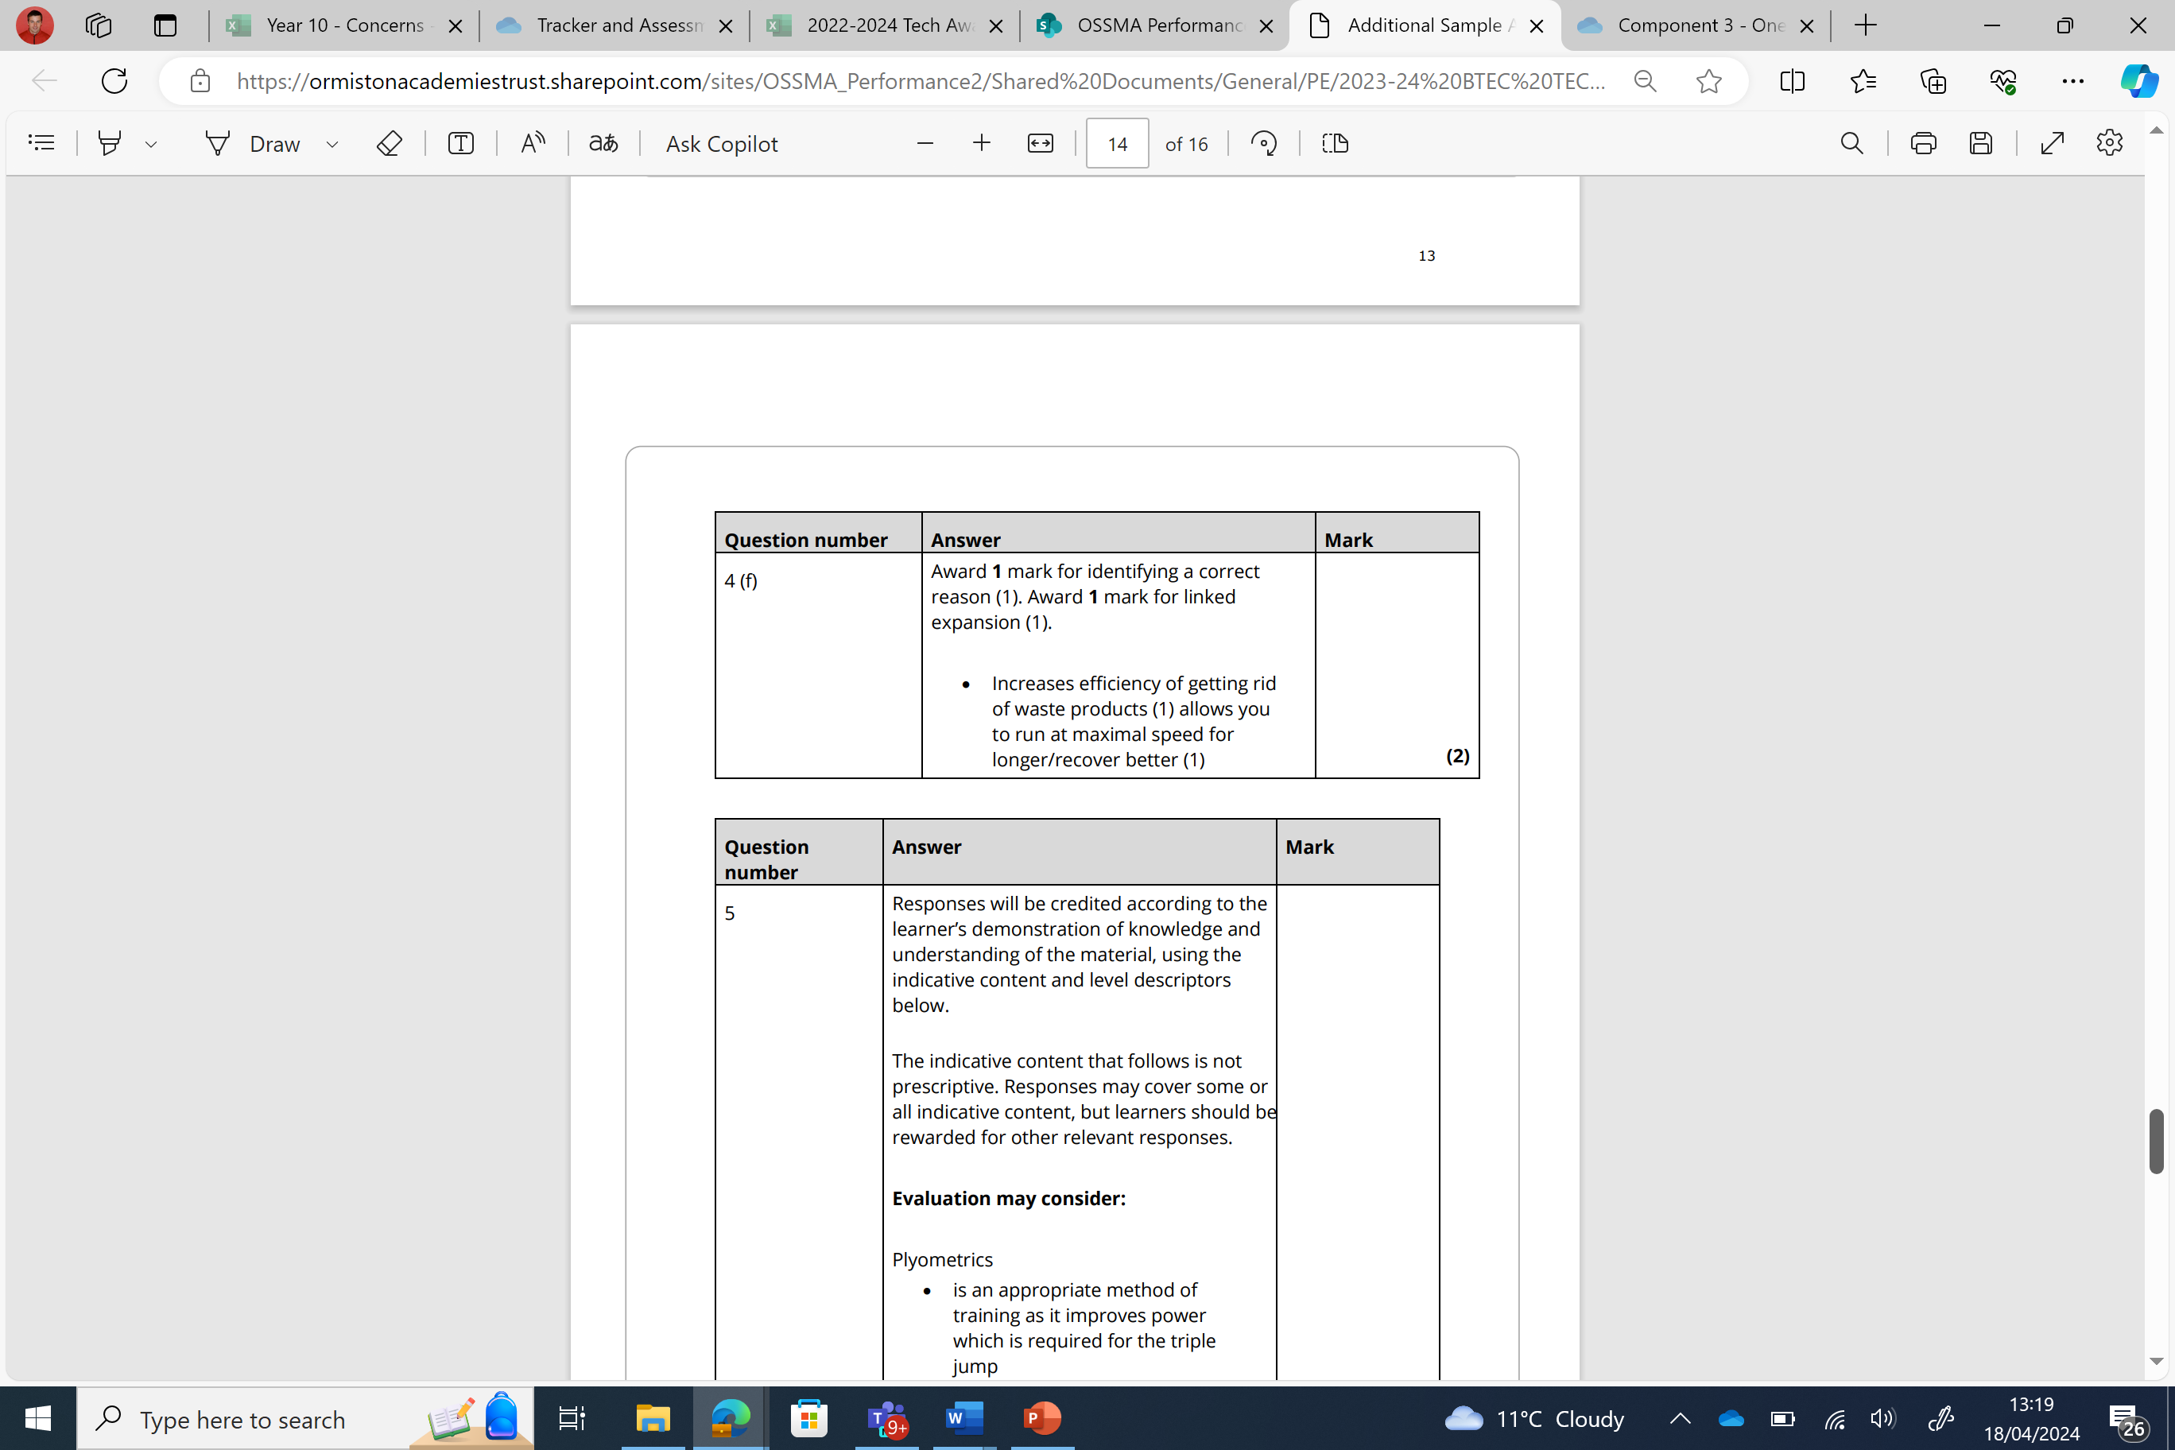
Question 4 – F
Answer

Slide 29
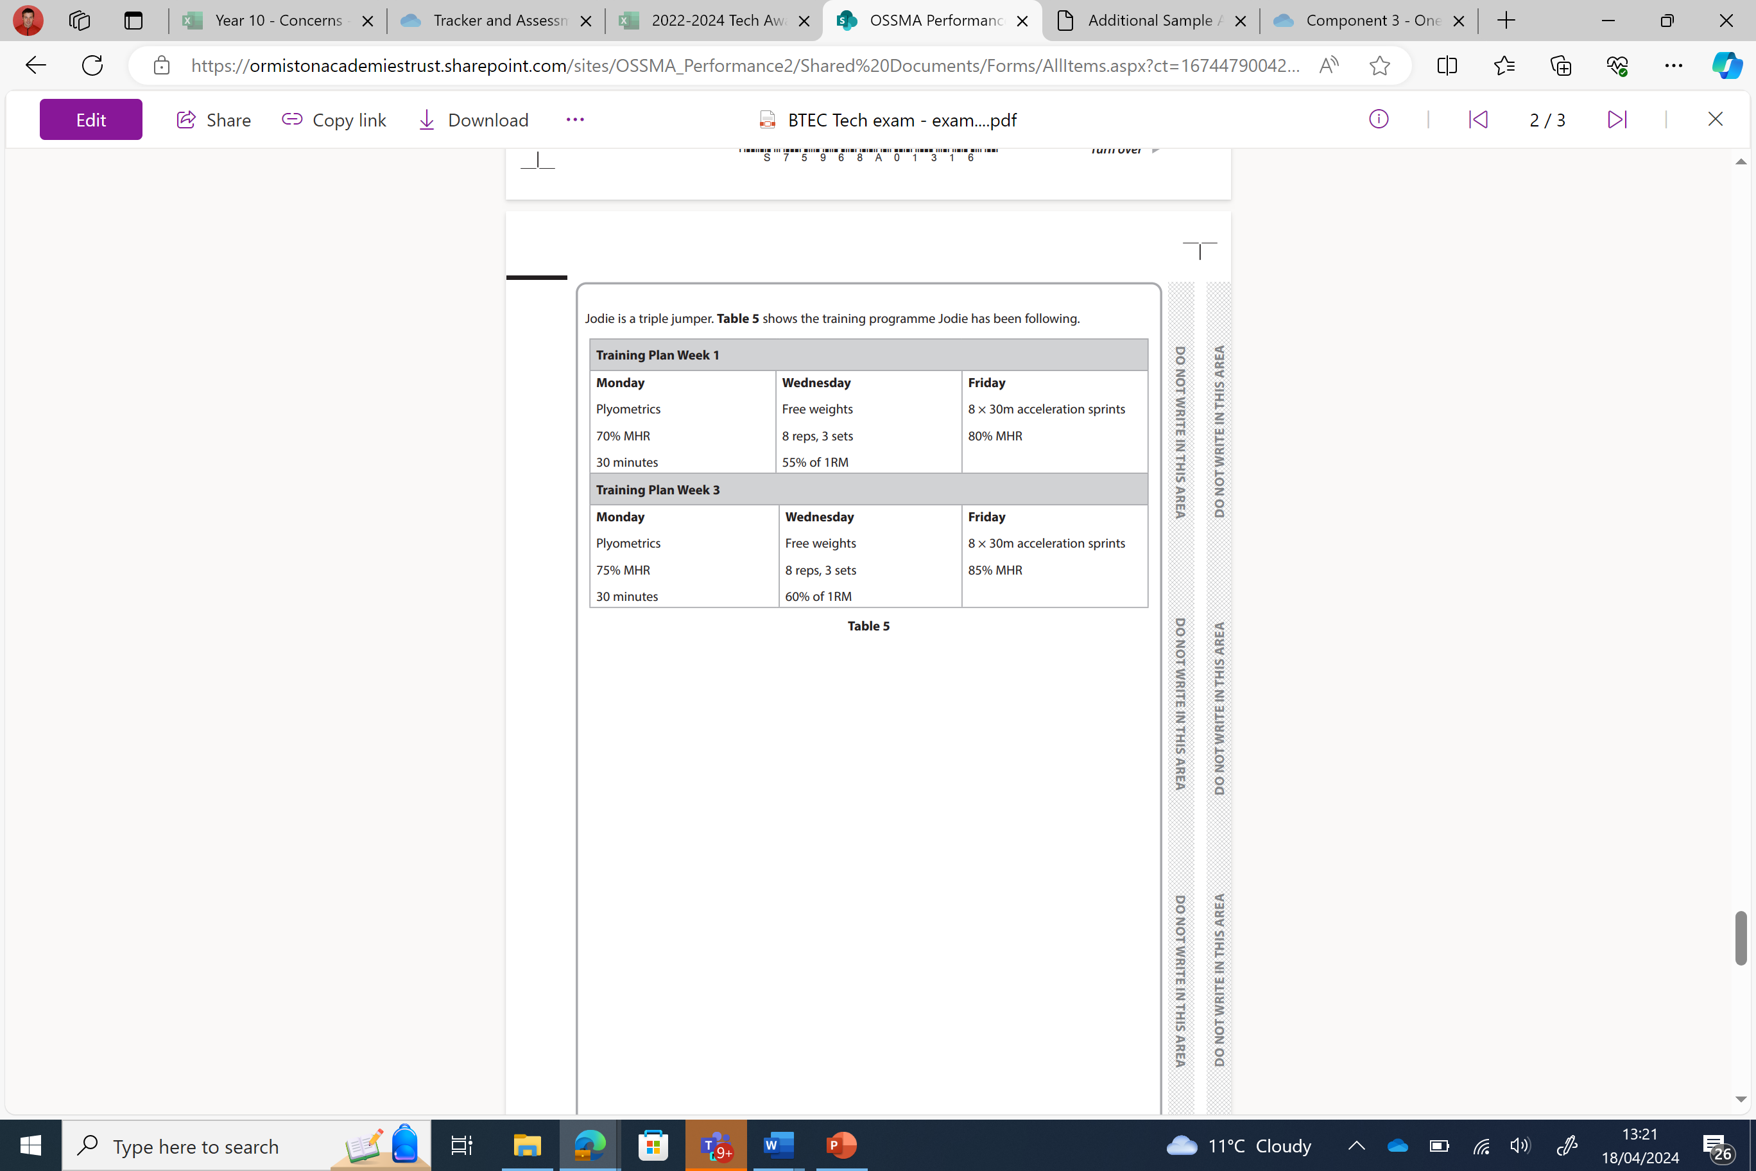
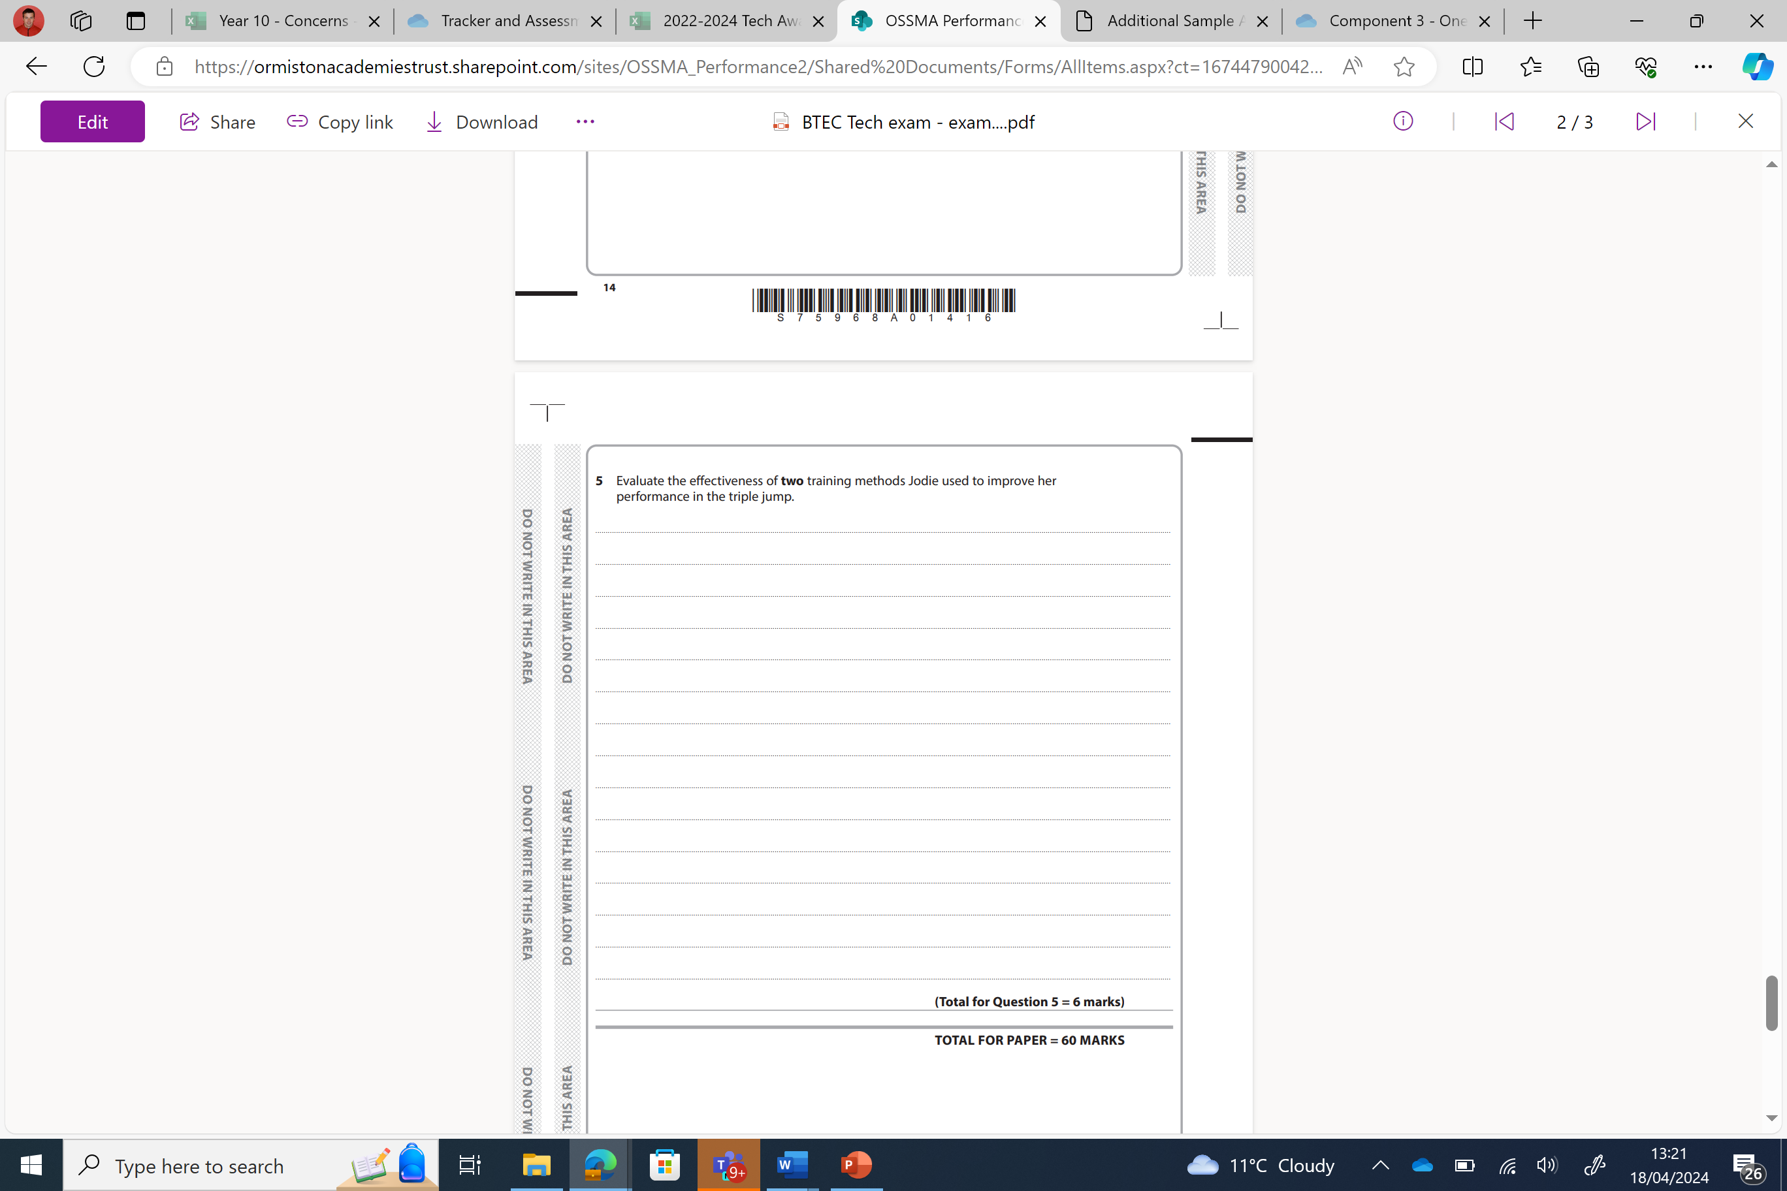
Question 5 –(6 marks)
Answer

Slide 30
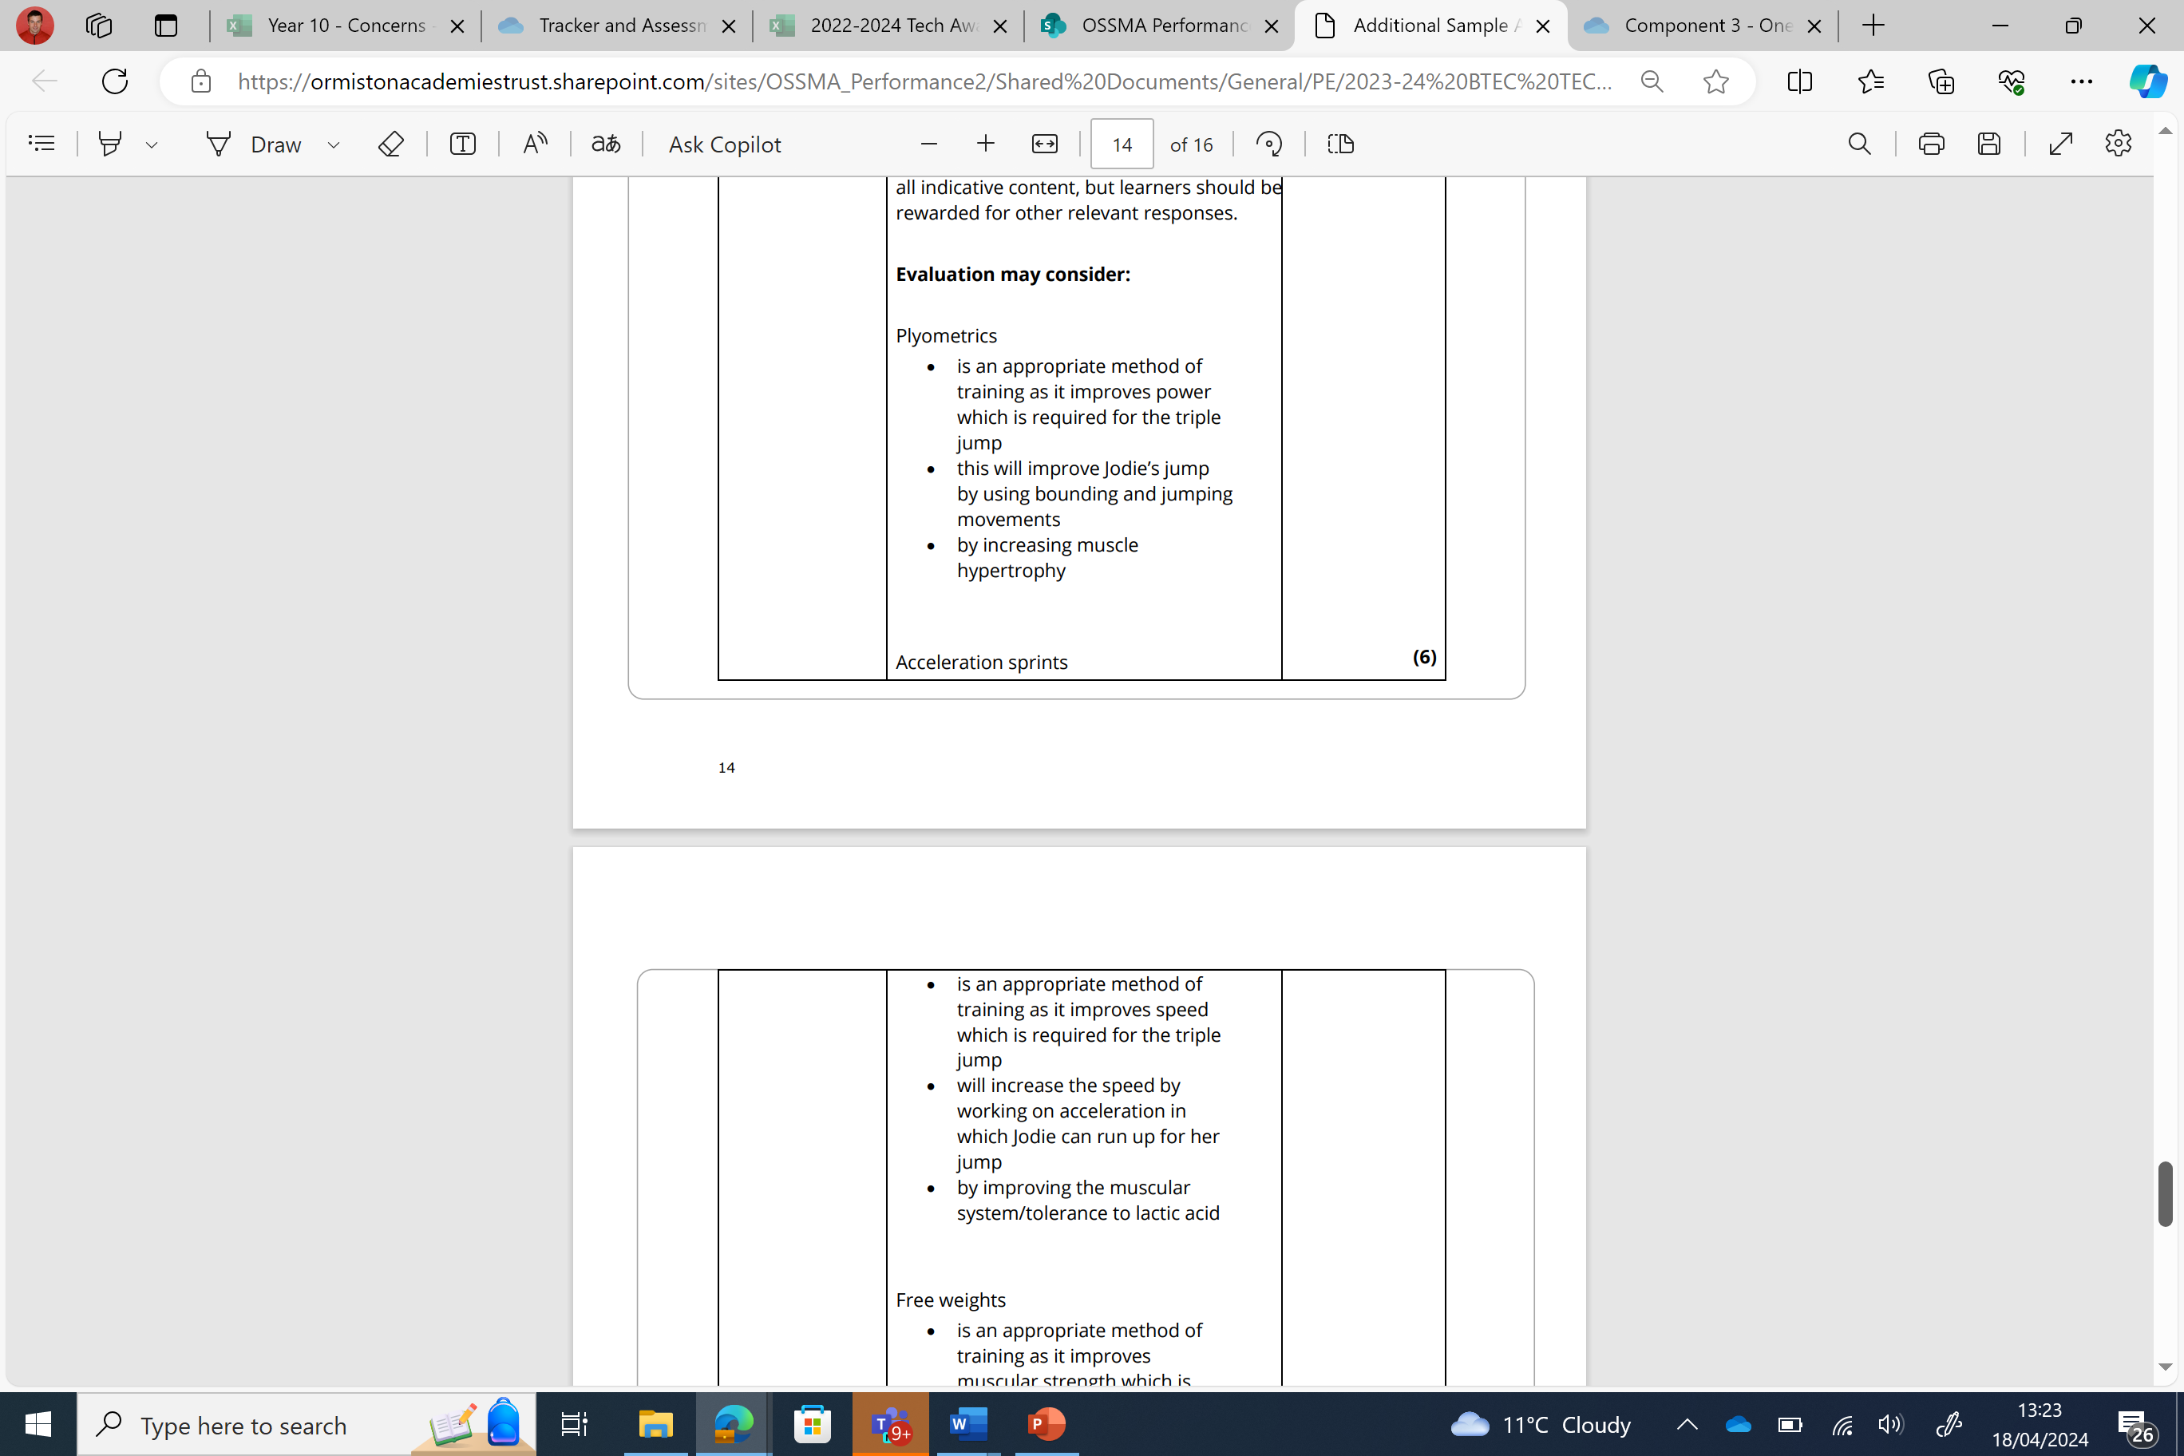
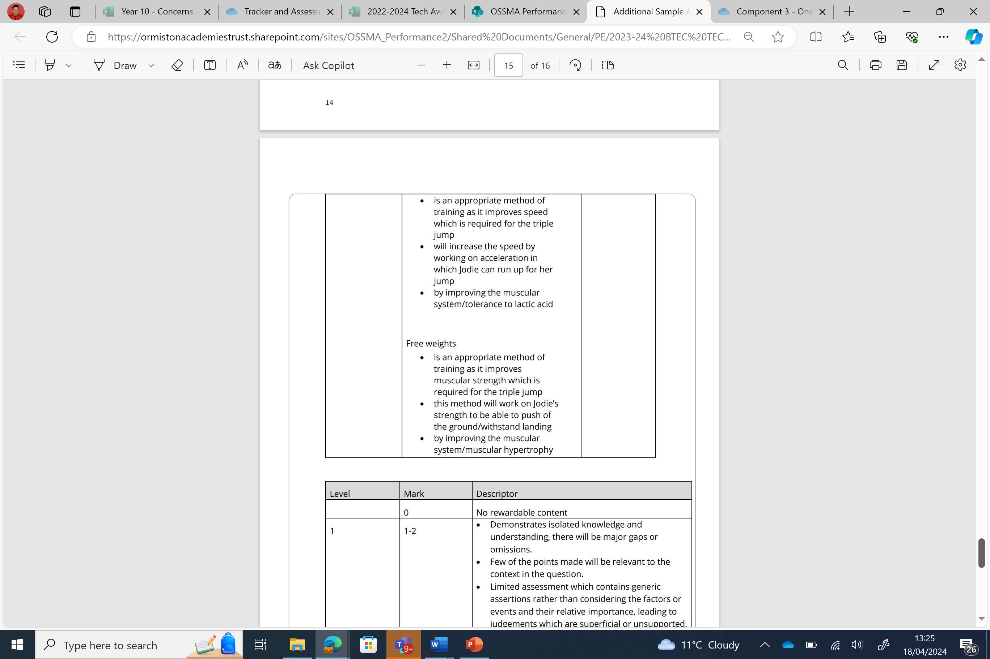






Question 5 –(6 marks)
Answer

